Slide 1
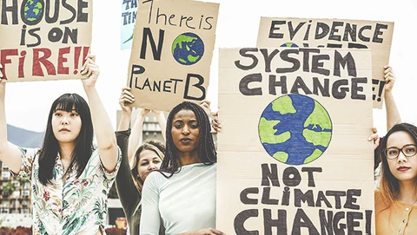
Module 1.2
Environmental Justice Fundamentals for Groundwater Hydrologists
https://www.alterecofoods.com/blogs/blog/environmental-justice-explained-and-what-you-can-do
Notes:
Slide developed by Tom Gleeson

Slide 2
Sharing and citing these slides:
© 2022 Gleeson, Mohan, Okibe, Horoscoe, Huggins, Ng and Jacoby
Published by the University of Victoria, Victoria, British Columbia V8P 5C2 Canada
Except where otherwise noted, this work is licensed under a Creative Commons Attribution-NonCommercial-ShareAlike 4.0 International License (https://creativecommons.org/licenses/by-nc-sa/4.0/), which permits use, sharing, adaptation, distribution and reproduction in any medium or format, as long as you give appropriate credit to the original author(s) and the source, and you distribute your contributions under the same license as the original.
Please cite as:
Gleeson, Mohan, Okibe, Horoscoe, Huggins, Ng and Jacoby (2022) ‘Environmental Justice Fundamentals for groundwater hydrologists’, University of Victoria.
This work is licensed under CC BY-NC-SA 4.0.
Notes:
Slide developed by Tom Gleeson

Slide 3
Guide to organization of slides
(for other instructors…)
Start with acknowledging team that developed and advised on slides, and your positionality and approach from your social location (change slides 5-7 to be from you)
Introduce environmental racism and injustice as a hook; and clarify argument why this is important for engineers (or geoscientists or whomever you teach)
Define and discuss environmental racism manifestations and causes
Describe Indigenous aspects of environmental racism (for context and background for methodologies described below)
Discuss data of groundwater-related environmental injustice around the world (to put issues in broad context) and few examples from around the world (you could substitute others from end of slide deck)
Define and discuss environmental justice and toolbox
Describe different tools in toolbox (emphasising what is important for your students)
Additional slides with other case studies and than additional resources for student to continue their learning
Notes:
Slide developed by Tom Gleeson

Slide 4
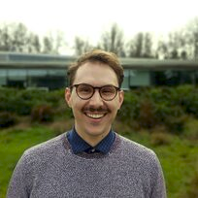
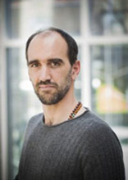
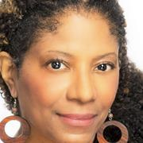
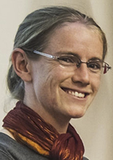
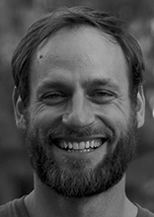
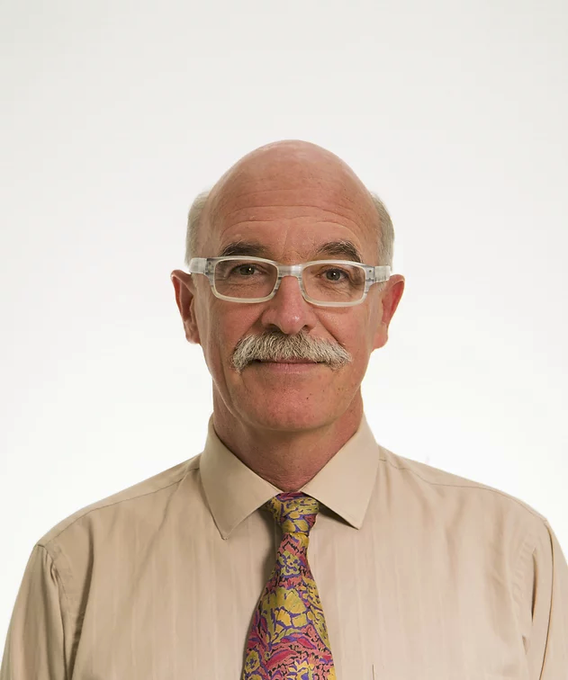
Environmental justice, environmental racism and anti-racism practices for hydrogeologists/groundwater hydrologists
These slides were developed by:
Chinchu Mohan, Summer Okibe, Noella Horoscoe, Xander Huggins, Tom Gleeson, Crystal Ng, Ally Jacoby
With advice and support from:
Ingrid Waldron, Heather Buckley, Kris Dubrawski, Ryan Emanuel, Crystal Tremblay, Debra Perrone, Gilles Wendling, Pamela Wolf
Notes:
Slide developed by Tom Gleeson

Slide 5
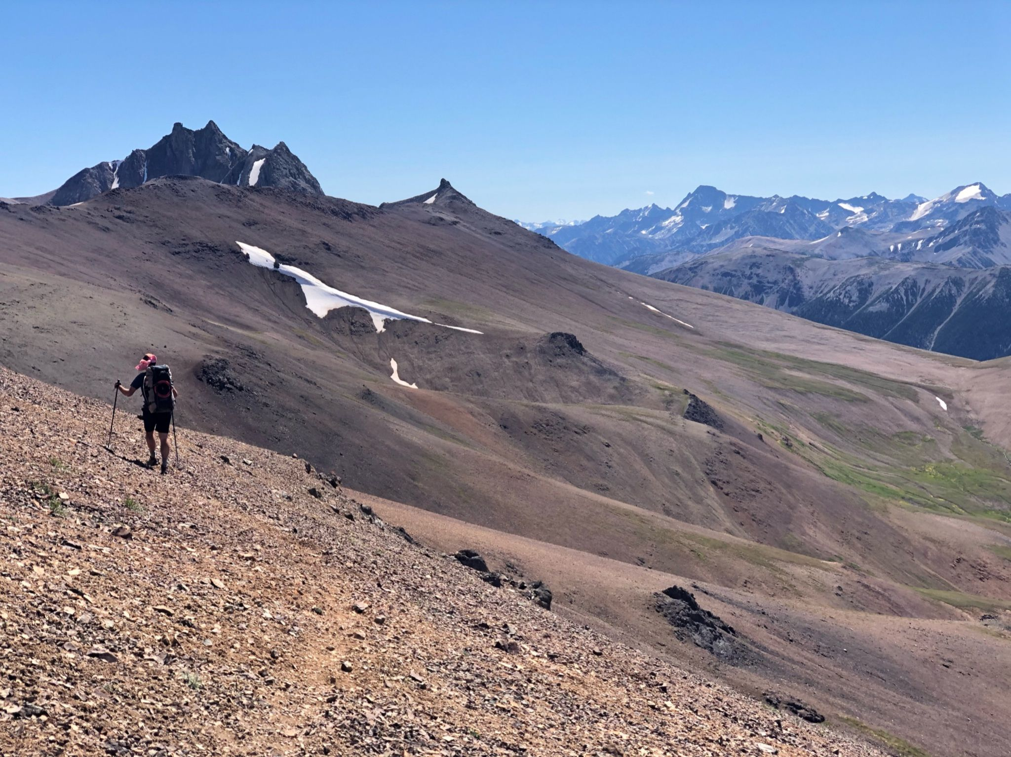
I have become passionate about these issues and am on my own learning journey
Notes:
Slide developed by Tom Gleeson to be modified in future or by other people who may use these slides

Slide 6
Positionality
I acknowledge my social location as a white, settler, male academic with many unearned privileges
I also acknowledge each student has a different social location and some experience daily the current and historical impacts of racism, colonialism, misogyny etc.
I endeavor to make this a safe space for everyone, and with these sometimes difficult topics, I encourage you follow suggestions for self care like these.
Notes:
These are written by Tom Gleeson in January 2022 to be modified in future or by other people who may use these slides

Slide 7
My approach from my social location
Completed training in cultural acumen and anti-racism through UVic and externally, and committed to ongoing learning
Develop teaching content with diverse team and seek advice from advisors that are BIPOC and/or experts in this content
Include available materials directly from BIPOC sources while minimizing burden such as repeated class visits. Incorporate BIPOC speakers if not a burden and with a reciprocity practice.
Co-lead ‘Water Underground Talks’ initiative to bring diverse voices into classroom
Partner with Indigneous communities in research, always aiming to apply best practices of working in a good way
Be open to learning, feedback and criticism to do better in the future
Notes:
These are written by Tom Gleeson in January 2022 to be modified in future or by other people who may use these slides

Slide 8
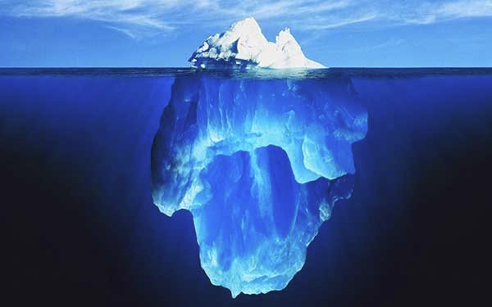
We introduce aspects of environmental justice and Indigenous Studies in the context of water resources and try to provide additional resources to deepen your learning
Environmental justice and Indigenous Studies are large, important disciplines with vast literatures
https://octavianreport.com/rostrum/why-icebergs-are-still-dangerous/
Notes:
slide developed by Tom Gleeson

Slide 9
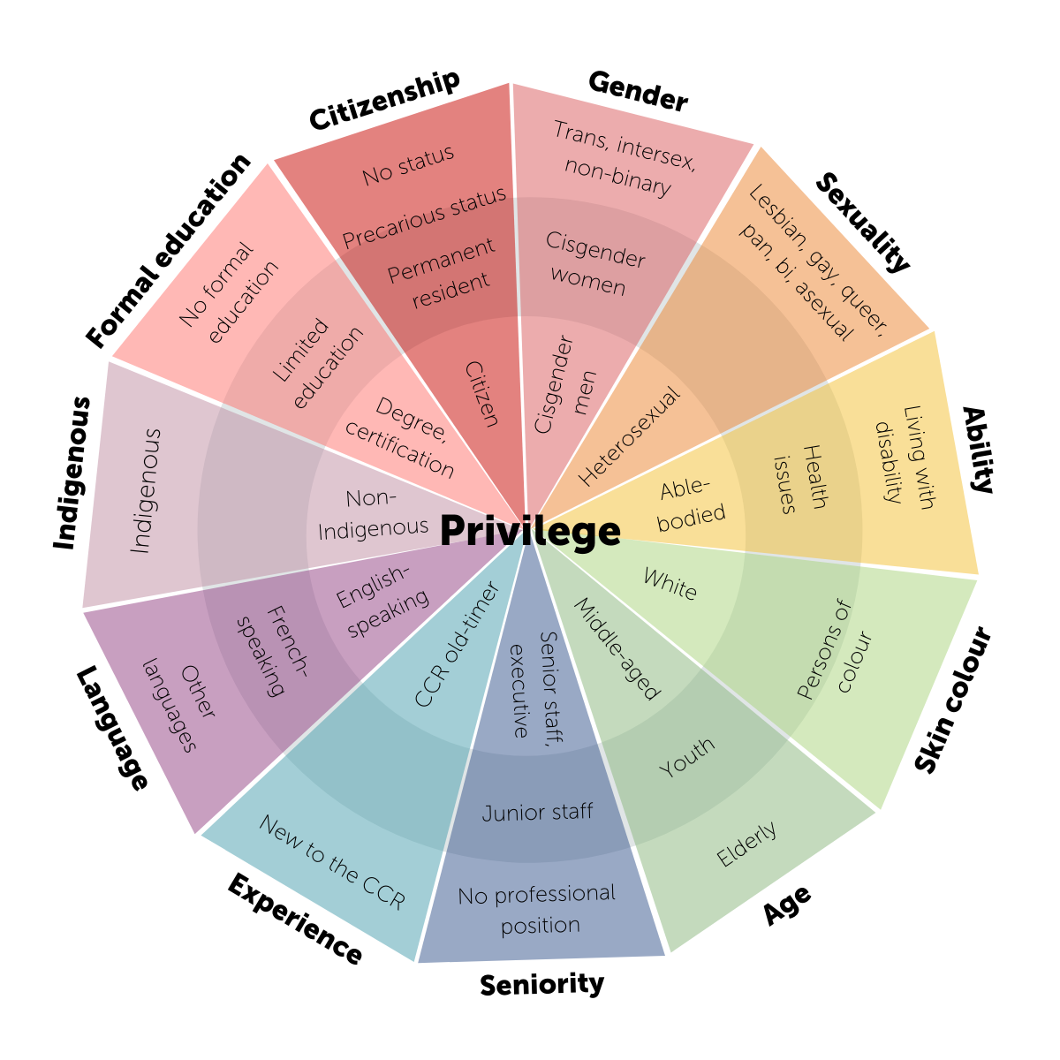
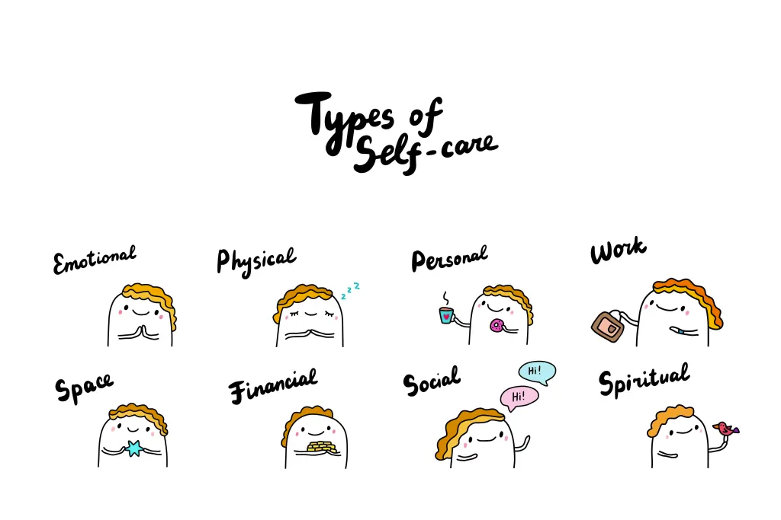
It is crucial remember your social location, maintain this class as a safe space and take care of yourself during and after these brave conversations
Safe space image
Brave conversation image
Privilege wheel image
Self care image
Notes:
Slide developed by Tom Gleeson

Slide 10
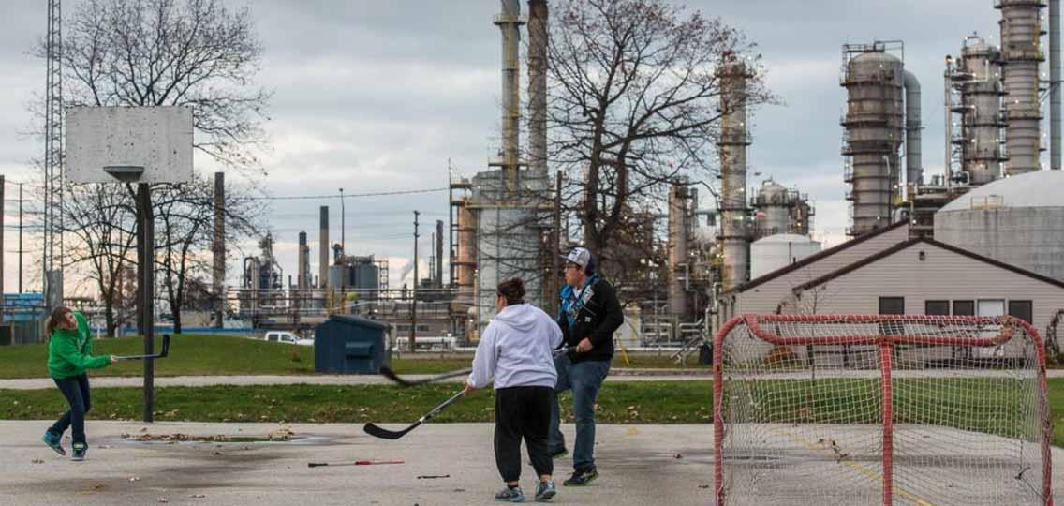
Environmental racism in Canada
https://ecojustice.ca/environmental-racism-in-canada /
Notes:
Slide developed by Tom Gleeson

Slide 11
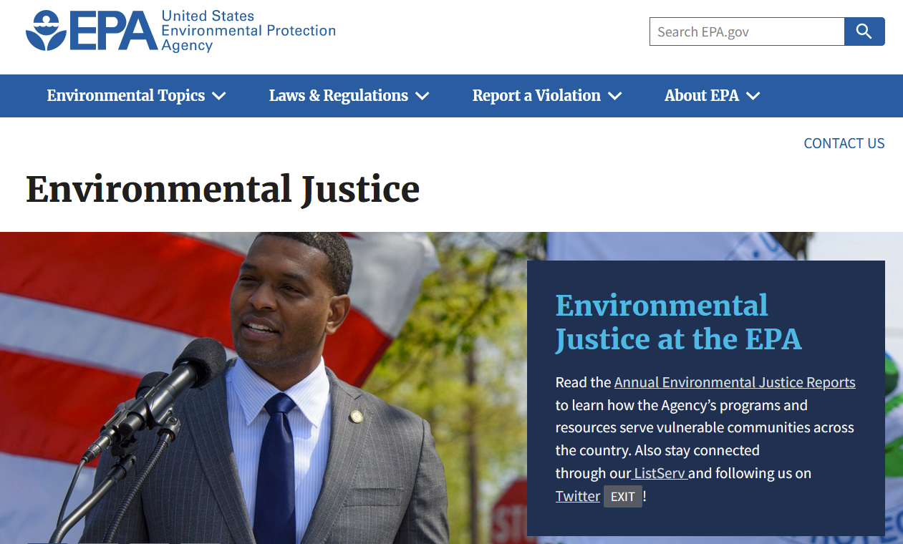
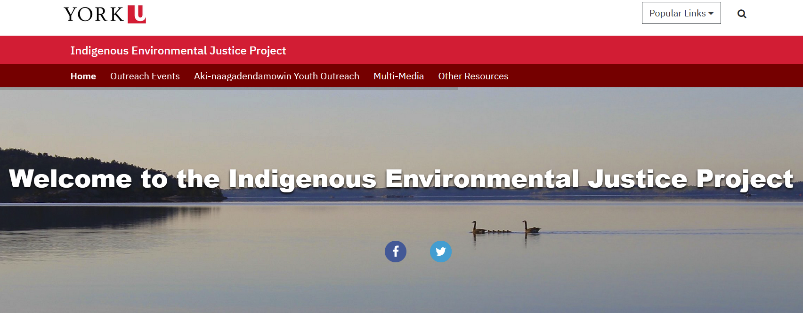
Environmental justice provides tools to combat environmental racism
https://iejproject.info.yorku.ca/
https://www.epa.gov/environmentaljustice
Notes:
Slide developed by Tom Gleeson

Slide 12
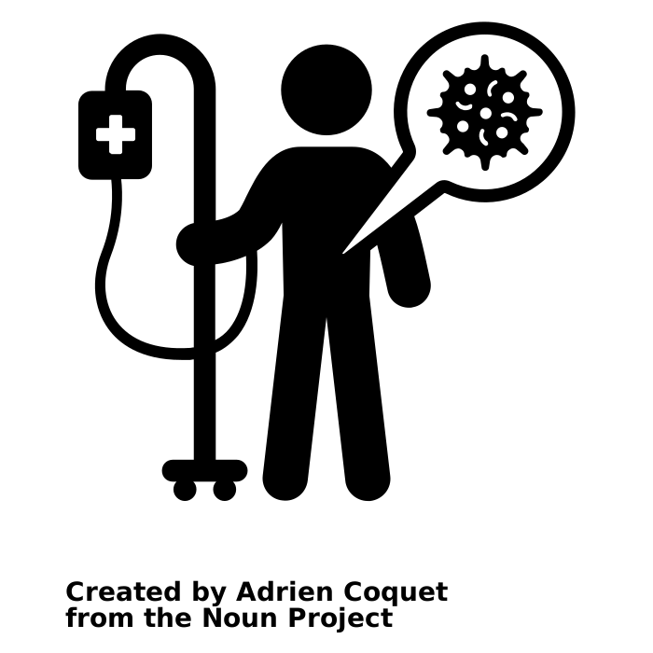
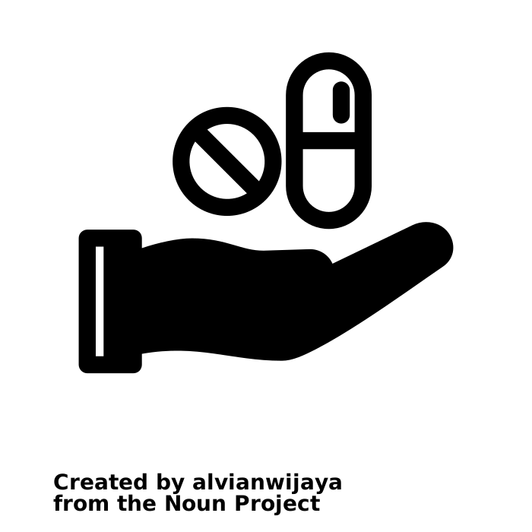
Environmental racism is the disease…
(caused by colonialism, capitalism etc.)
… environmental justice is the medicine
Metaphor from Ingrid Waldron; images from noun project: disease and medicine
Notes:
Metaphor from Ingrid Waldron; images from noun project: disease and medicine; slide developed by Tom Gleeson

Slide 13
Environmental justice and racism are important concepts for engineers
Technical
Practice Pillar
Professional
Practice Pillar
A foundation of engineering ethics
Noun project: bridge
Notes:
slide developed by Tom Gleeson

Slide 14
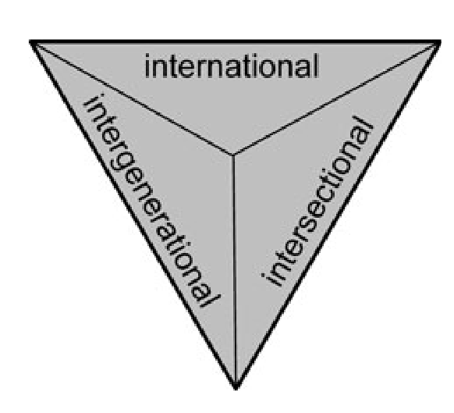
Engineering code of ethics consistent with environmental justice
Role to promote environmental justice + redress environmental racism
through engineering practice 🤯
Three dimensions of justice and fairness
Jerneck 2011
Notes:
slide developed by Xander Huggins

Slide 15
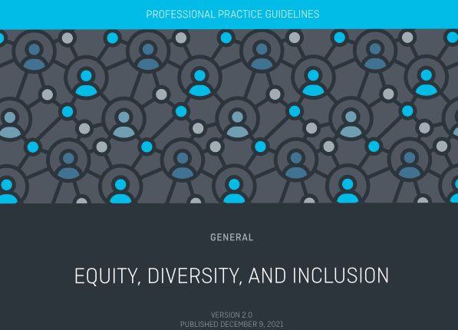
Engineering initiatives consistent with environmental justice
EDI professional practice guidelines
Notes:
slide developed by Xander Huggins and Tom Gleeson

Slide 16
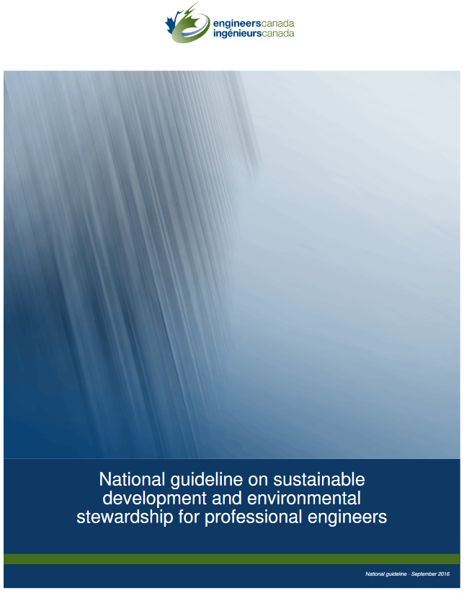
Engineers Canada guidelines consistent with environmental justice
“Engineers are required to take a wider perspective including goals such as poverty alleviation, social justice and local and global connections.”
10 GUIDELINES: 3rd guideline: Consider social impacts
Values to be considered include regional, local and community concerns, quality of life and other social concerns related to environmental impact along with traditional and cultural values including First Nations where applicable.
Define and assess all societal needs, issues and concerns at the local and community level first to serve the public interest.
Seek information and input on societal values.
Consider the local societal acceptance of the project over its life cycle, and potential effects due to other displaced technology and techniques.
Determine and articulate the positive and negative effects of proposed actions considering local societal needs in the short-term as well as over the long-term
Notes:
slide developed by Xander Huggins

Slide 17
Natural scientists and engineers are being called to environmental justice through reconciliation
Wong et al’s 10 Calls to Action for Natural Scientists
1. We call on natural scientists to understand the socio-political landscape around their research sites.
2. We call on natural scientists to recognize that generating knowledge about the land is a goal shared with Indigenous peoples and to seek meaningful relationships and possible collaboration for better outcomes for all involved
3. We call on natural scientists to enable knowledge sharing and knowledge co-production
4. We call on natural scientists studying animals to seek out advice from Elders for respectful ways of handling animals.
5. We call upon natural scientists to provide meaningful opportunities for Indigenous community members, particularly youth, to experience and participate in science.
6. To decolonize the landscape, we call on natural scientists to incorporate Indigenous place names as permitted.
7. We call upon natural scientists and their students to take a course on Indigenous history and rights.
8. We call on funding bodies to change approaches to funding.
9. We call on editors of all scientific journals to recognize that publication of research on Indigenous Knowledge and cultural resources require review and permission from the respective Indigenous communities.
10. We call on natural scientists and postsecondary research institutions to develop a new vision for conducting natural science: fundamentally mainstreaming reconciliation in all aspects of the scientific endeavor, from formulation to completion.
Notes:
slide developed by Tom Gleeson

Slide 18
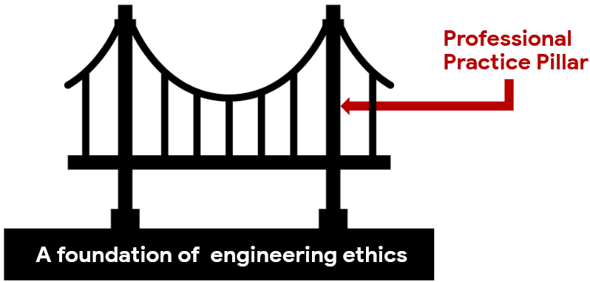
Improved equity and anti-racism practice as a professional
Cultural Intelligence
Cultural Acumen Training
Anti-racism training
https://www.osgoodepd.ca/programs_on_demand/equity-diversity-inclusion-cultural-competence-for-legal-professionals/
Notes:
slide developed by Tom Gleeson

Slide 19
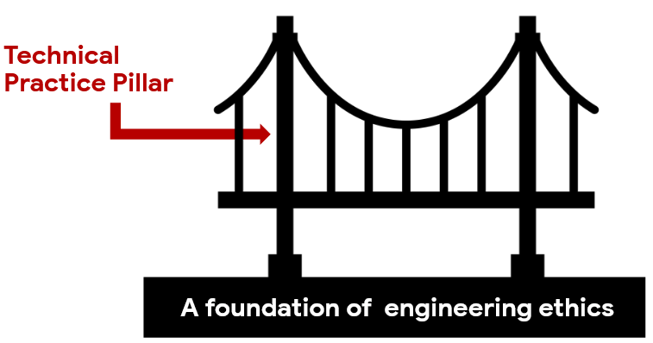
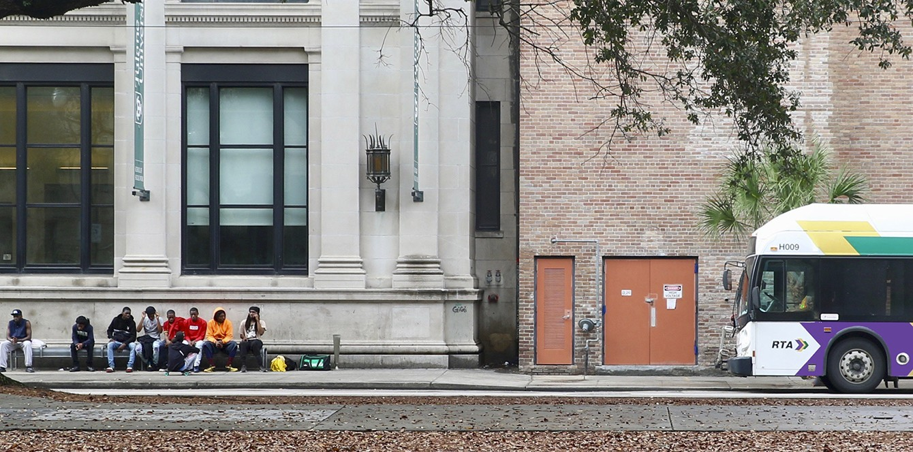
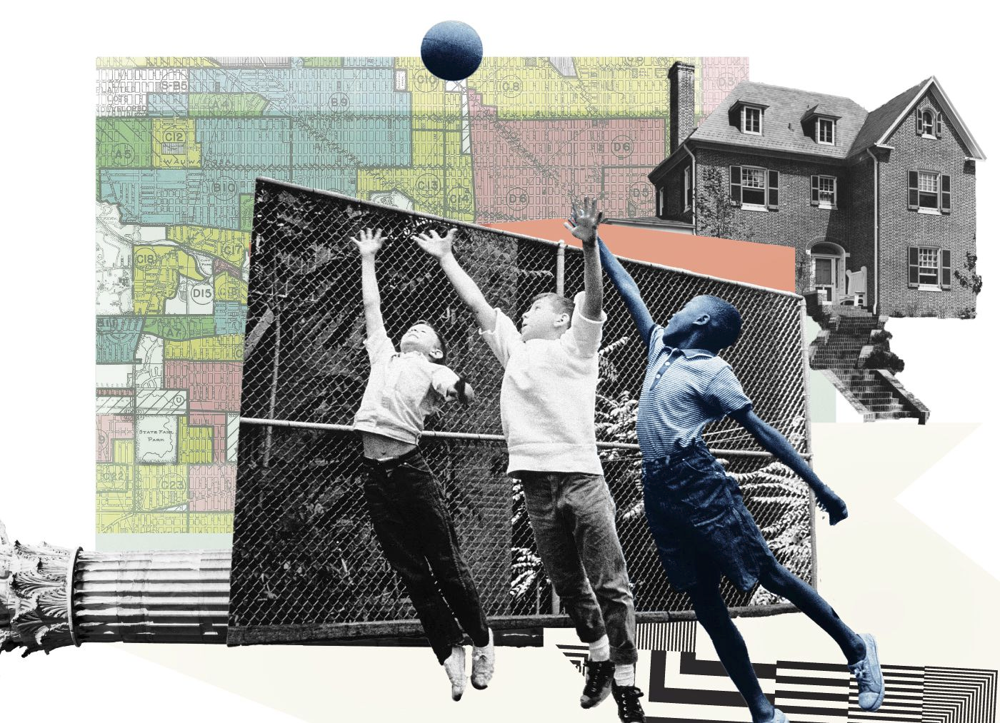
Integrating environmental justice and anti-racism into technical practice
Environmental racism impacts environmental policy, water resources, environmental engineering etc.
Racism has shaped public transit
Urban planning and housing development is shaped by racist housing rules
https://ecojustice.ca/environmental-racism-in-canada/
https://kinder.rice.edu/urbanedge/2020/08/24/transportation-racism-has-shaped-public-transit-america-inequalities
https://www.vox.com/22252625/america-racist-housing-rules-how-to-fix
Notes:
slide developed by Xander Huggins and Tom Gleeson

Slide 20
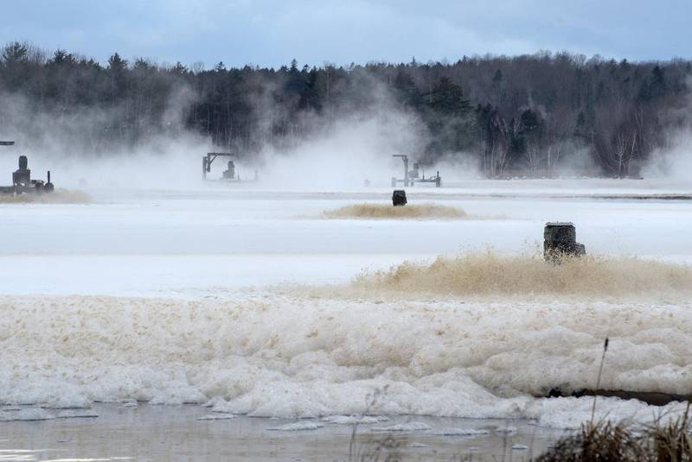
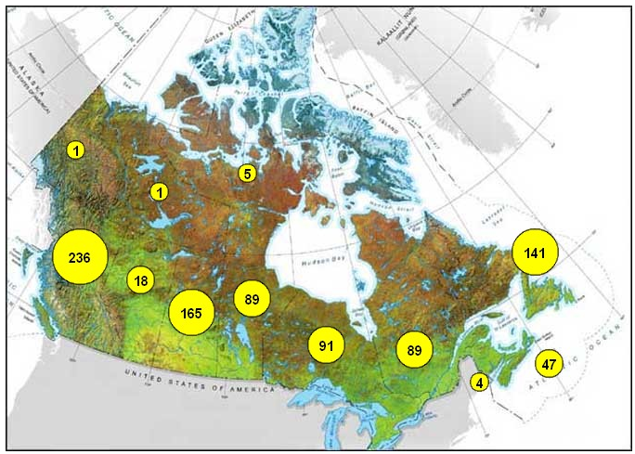
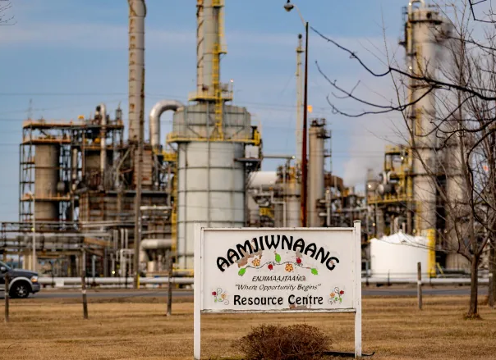
Environmental justice and environmental racism are products of policy, water management and environmental engineering
Boat Harbour, NS
Boil water advisories
Aamjiwnaang First Nation
Notes:
slide developed by Xander Huggins and Tom Gleeson

Slide 21
First we need to talk about the disease…
environmental racism and what causes it…
colonialism, capitalism, racism etc.
Metaphor from Ingrid Waldron in this article; images from noun project: disease
Notes:
Metaphor from Ingrid Waldron; images from noun project: disease; slide developed by Tom Gleeson

Slide 22
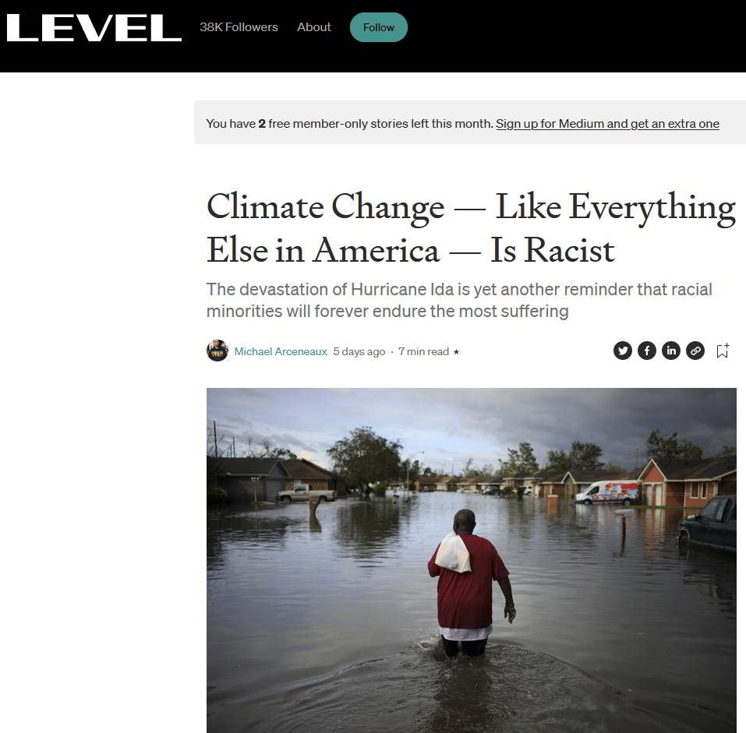
Environmental racism in the news
https://level.medium.com/climate-change-like-everything-else-in-america-is-racist-29f34d30eb04
Notes:
slide developed by Tom Gleeson

Slide 23
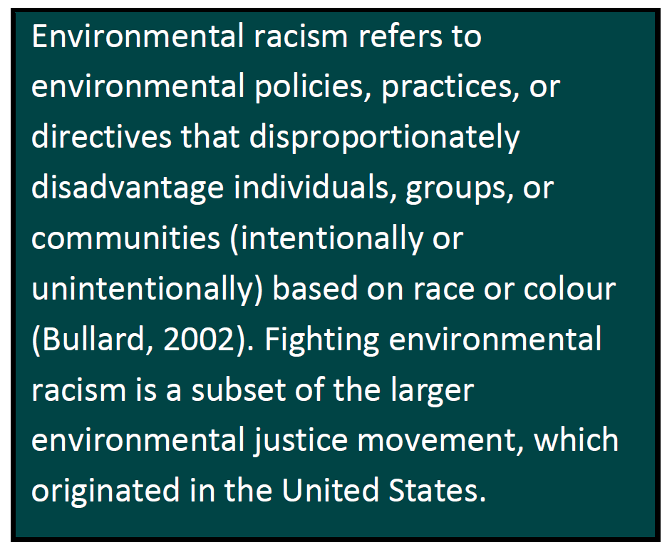
Environmental injustice
Environmental racism
Systemic
Racism
Many environmental injustices are environmental racism since systemic racism is so common, and people with socio-economic and other disparities are often racialized
e.g. Incarceration rates
Racialized violence by police
Definition from WALDRON Ingrid, 2020 “Environmental Racism in Canada” https://www.enrichproject.org/
Notes:
slide developed by Tom Gleeson
Kristian Dubrawski suggested it is Important to note know that environmental justice is often considered with environmental health (environmental determinants of human health) rather than ecosystem health (how healthy the ecosystem is). Some are more leading towards systematic health - holistic, including more than-human-world

Slide 24
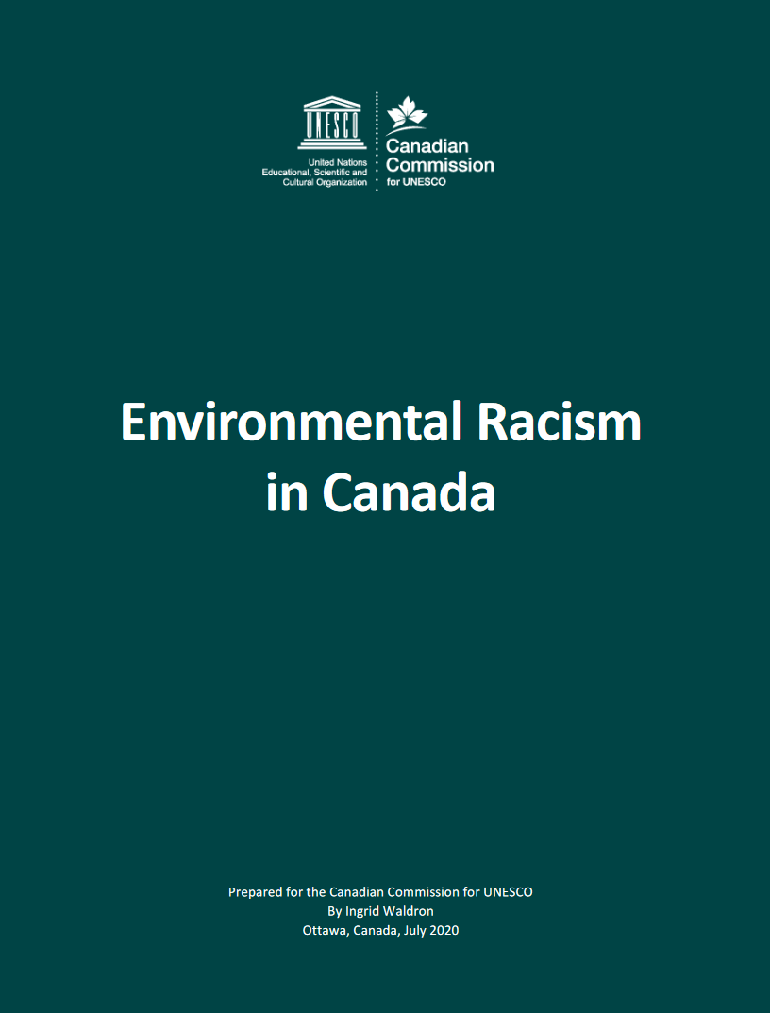
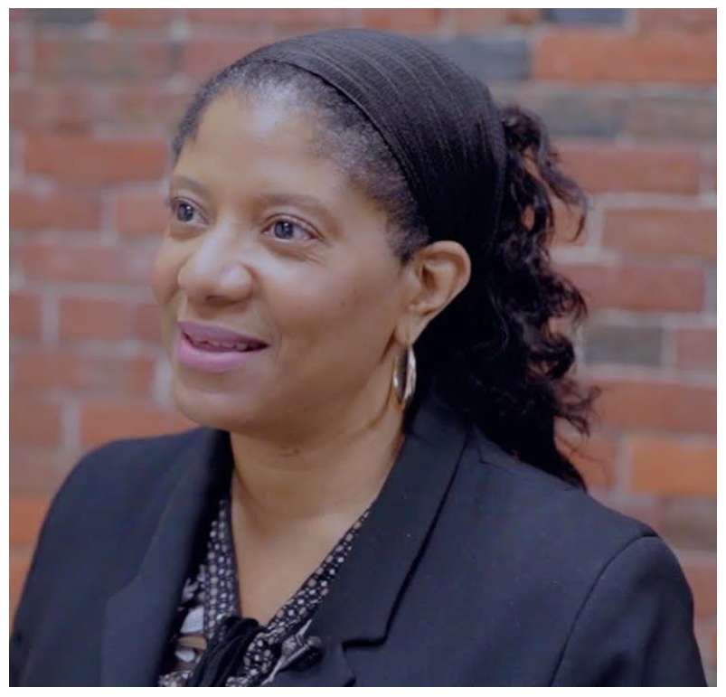
Defining environmental racism
WALDRON Ingrid, 2020 “Environmental Racism in Canada” https://www.enrichproject.org/
Notes:
slide developed by Tom Gleeson

Slide 25
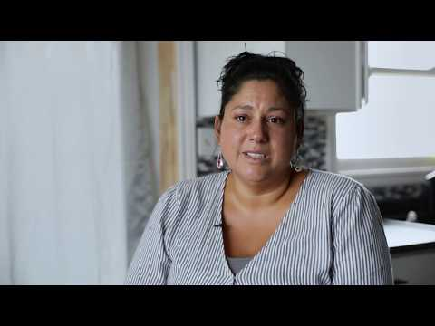
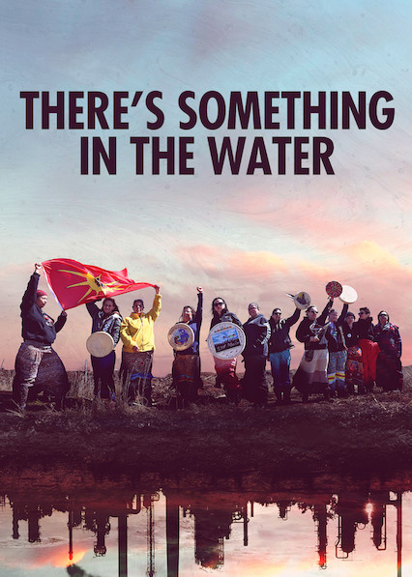
Example of environmental racism in Nova Scotia
Directed by Elliot Page.
Notes:
slide developed by Tom Gleeson

Slide 26
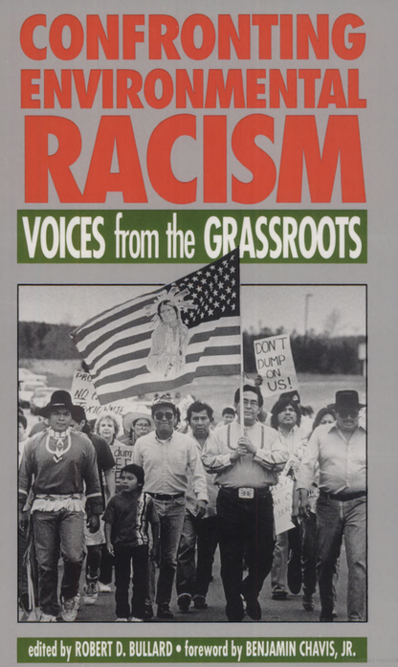
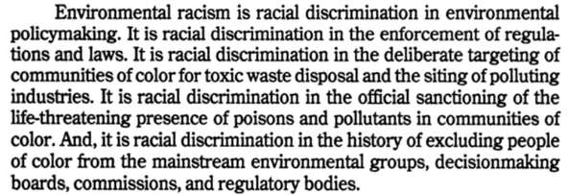
‘Aspects’ of environmental racism
book link
Notes:
slide developed by Tom Gleeson

Slide 27
Environmental racism has most often focused on water contamination/quality
We include water quantity and resources as part of environmental racism where the examples meet the ‘aspects’ on the last slide
(aside from poisons and pollutants)
Water QUALITY examples of environmental racism:
The disproportionate location and greater exposure of Indigenous and racialized communities to contamination and pollution from polluting industries and other environmentally hazardous activities;
The lack of political power these communities have for resisting the placement of industrial polluters in their communities;
The implementation of policies that sanction the harmful and, in many cases, life-threatening presence of poisons in these communities;
The disproportionate negative impacts of environmental policies that result in differential rates of cleanup of environmental contaminants in these communities; and
The history of excluding Indigenous and racialized communities from mainstream environmental groups decision-making boards, commissions, and regulatory bodies
(Bullard 2002 in Waldron 2020).
Notes:
slide developed by Tom Gleeson

Slide 28
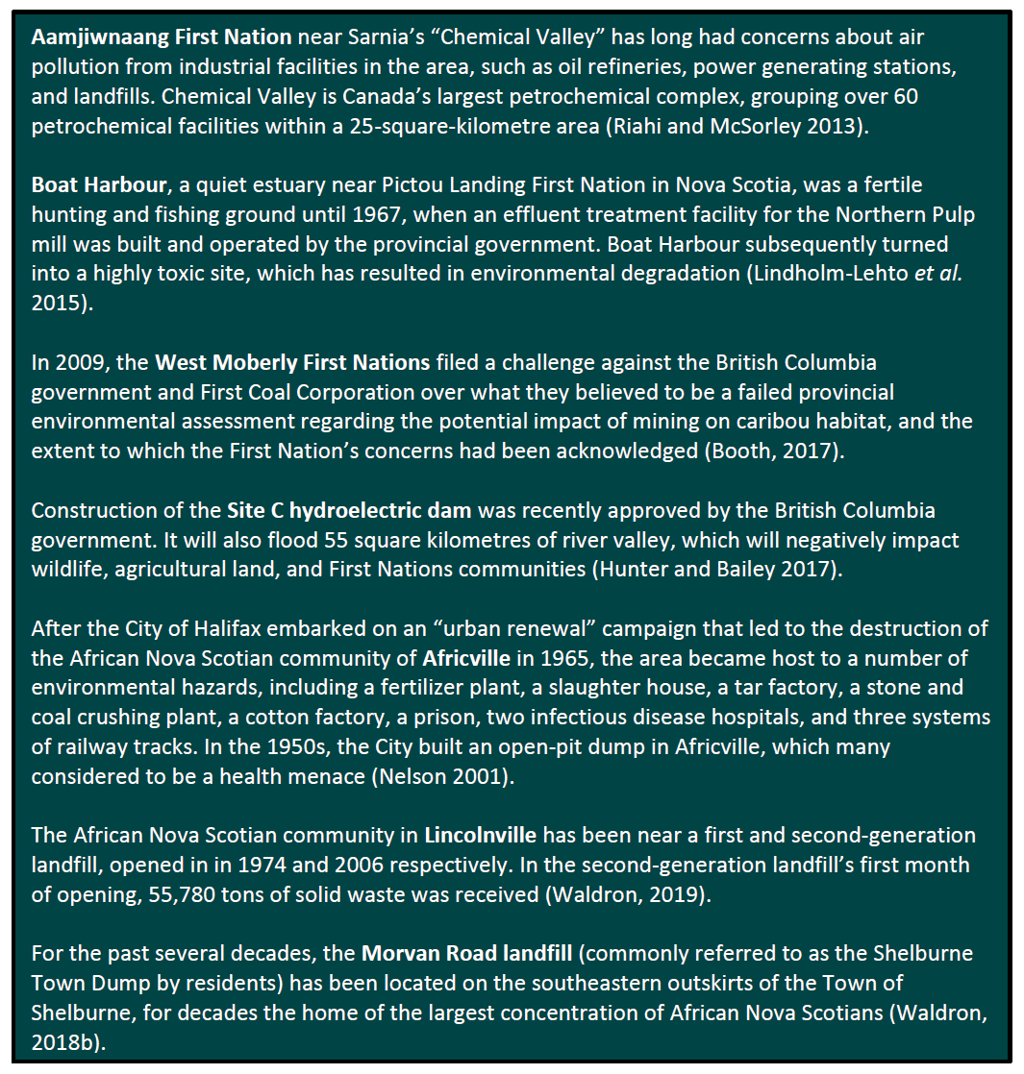
Other examples across Canada
water quantity example
WALDRON Ingrid, 2020 “Environmental Racism in Canada” https://www.enrichproject.org/
Notes:
slide developed by Tom Gleeson

Slide 29
Breakout groups!
What are the words and ideas that come up when you hear the words ‘Territory and treaty rights’, ‘settler colonialism’ and ‘Reconciliation and resurgence’
Notes:
Activity suggested by Noella Horoscoe.
IDEAS
Territory and treaty rights: Power of the first inhabitants, Authority, Law, land rights.
Settler colonialism: “The whiteman syndrome,” pain, anguish, and suffering of the colonized.
Reconciliation and resurgence: Peacemaking and acknowledgment of wrongdoings to the colonized.

Slide 30
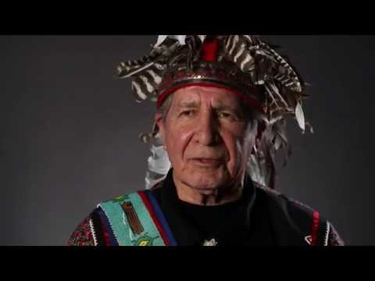
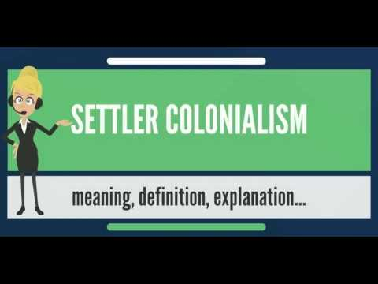
Settler Colonialism
Settler Colonialism is the act of engaging with and imposing colonial tactics upon a population that is native to a space with desirable resources, originally justified with the Doctrine of Discovery.
Settler colonialism is the contrast to exploitation colonialism, which entails the economic policy of conquering a country to exploit its population as cheap or free labor and its natural resources as raw material. In this way, settler colonialism lasts indefinitely, except in the rare event of complete evacuation or settler decolonization.
Settler colonialism is far more insidious and long lasting in comparison as it functions to assimilate and/or eliminate the original population into or from (in this case, Western) dominant social ideals while still leaving minoritized groups at a disadvantage.
Doctrine of Discovery
Other videos to check out…
Useful description of Settler Colonialism (unfortunately by a white robot
Johnny Appleseed & the Legacy of Settler Colonialism
Notes:
Text of slide written by Noella Horoscoe, edited by Summer Okibe and videos added by Tom Gleeson (Nov 2021-Jan 2022).

Slide 31
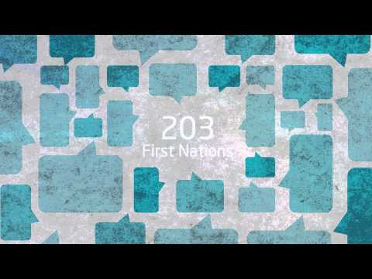
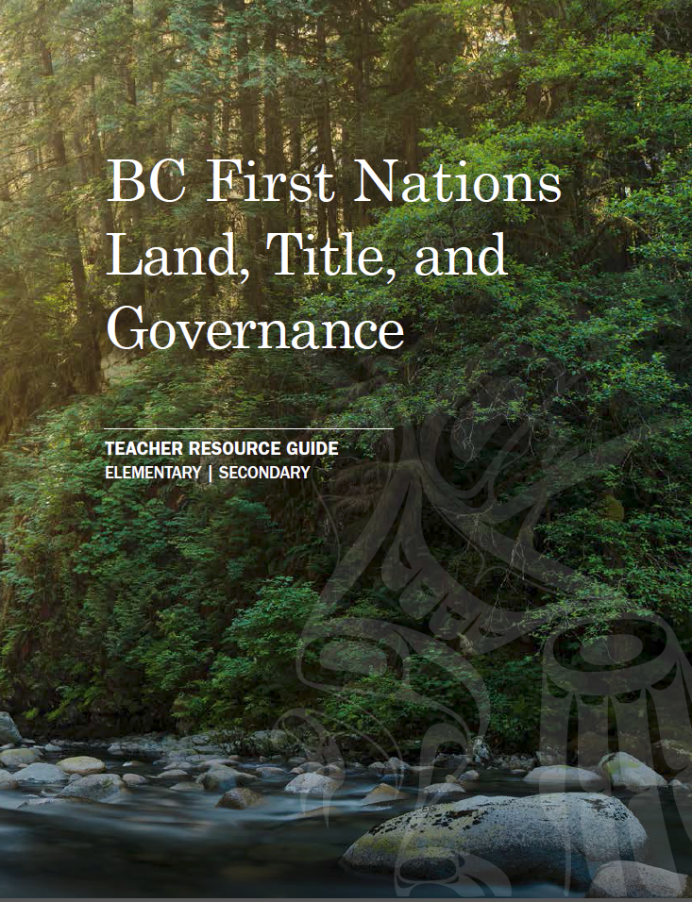
Territory and Treaty Rights
Canada and the British commonwealth acknowledge that Indigenous people hold the original title to the land here in so called Canada, but this has been disputed and redressed for centuries.
This title and the inherent rights of Indigenous people are both recognized in Section 25 of the Canadian Charter of Rights and Section 35 of the Constitution Act.
The original nature and intention of treaties was to create amicable relations between settlers and Indigenous peoples, but this has not historically always been the case. Section 35 confirmed that Aboriginal title and rights exist regardless of whether or not a treaty has been signed.
More info and videos
The case of Delgamuukw v. British Columbia (1997) has served a large role in the Treaty process here in BC. Delgamuukw confirmed that aboriginal title was never extinguished in BC and therefore still exists; it is a burden on Crown title; and when dealing with Crown land the government must consult with and may have to accommodate First Nations whose rights are affected.
However, section 35 does not define these rights, and uncertainty about how and where these rights apply can discourage investment and economic development in BC. Treaties provide certainty and will clarify aboriginal rights and title, ownership of BC's land and resources.
Link
Notes:
Text of slide written by Noella Horoscoe, edited by Summer Okibe and videos added by Tom Gleeson (Nov 2021-Jan 2022).

Slide 32
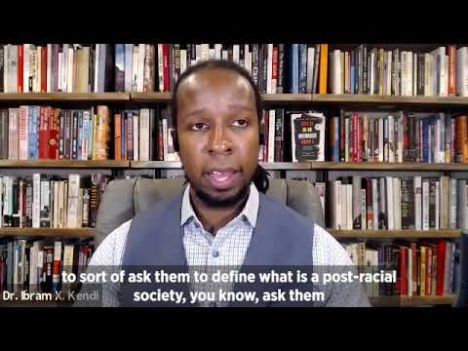
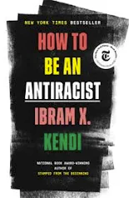
Racism - working definitions from Ibram X. Kendi
Racism - a marriage of racist policies and ideas that produces or normalizes racial inequalities
Racist policy - any measure that produces or sustains racial inequity between racial groups (policy = written or unwritten laws, rules, procedures, processes, guidelines that govern people)
Racist - one who is supporting a racist policy through their actions or inaction or expressing a racist idea.
Antiracist - one who is supporting the idea that racial groups are equals and none need developing, and is supporting policy that reduces racial inequality
Notes:
slide developed by Tom Gleeson

Slide 33
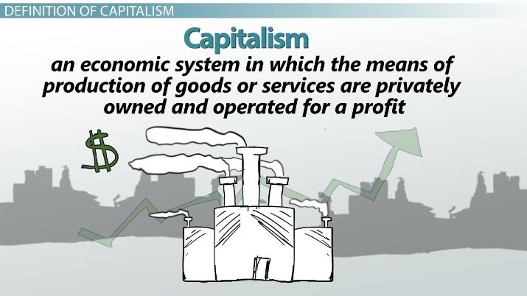
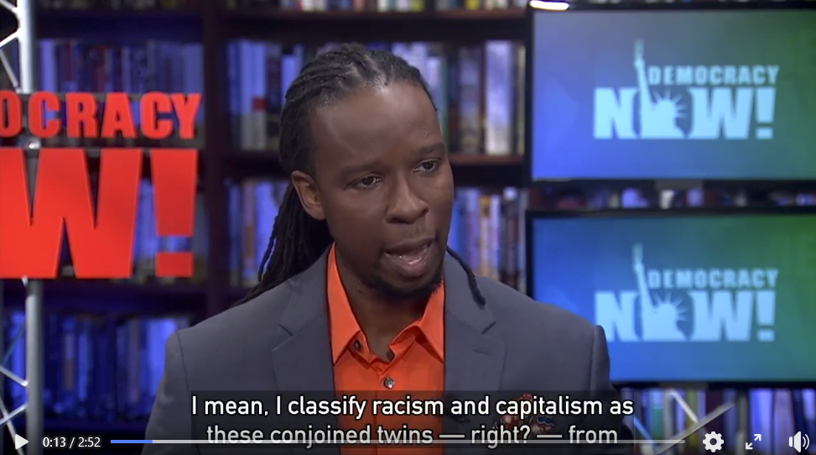
Capitalism
Capitalism has a deep and long entrenched history with colonialism. Some of the first instances of this in what we now know as Canada, are seen in the imposition of the fur trade and mercantilism style trade systems. Capitalism functioned then (and continues to now) as a tool to further the agenda of Colonizers, in their efforts to exploit natural resources.
The other facets of colonialism already discussed (eg: assimilation, resource extraction, exploitative labour) all still exist today, but are not as hegemonically accepted as capitalism. The way that colonialism uses capitalism as a tool to dispossess Indigenous peoples, is by assigning value to resources and land. This informs practices today,like resource extraction, in the way that land and resources are treated as capital.
Ibram X Kendi on Democracy Now from Facebook
Notes:
Text of slide written by Noella Horoscoe, image added by Summer Okibe and video added by Tom Gleeson (Jan 2022).
He·gem·o·ny = leadership or dominance, especially by one country or social group over others."Germany was united under Prussian hegemony after 1871"
hegemonically accepted = universally and unquestionably accepted by dominant culture

Slide 34
Capitalism is connected to racism, settler colonialism etc.
Racism
Patriarchy
White supremacy
Hierarchy
Imperialism
Capitalism
Individual over community
Misogyny
Man destroys nature
Settler Colonialism
Environmental destruction
Image redrawn from facebook post by Social Justice in ELT, with aspect less relevant to these notes shown as grey text.
Notes:
Slide developed by Tom Gleeson, with a small change of ‘Environmental destruction’ replacing ‘Environmental terrorism’.

Slide 35
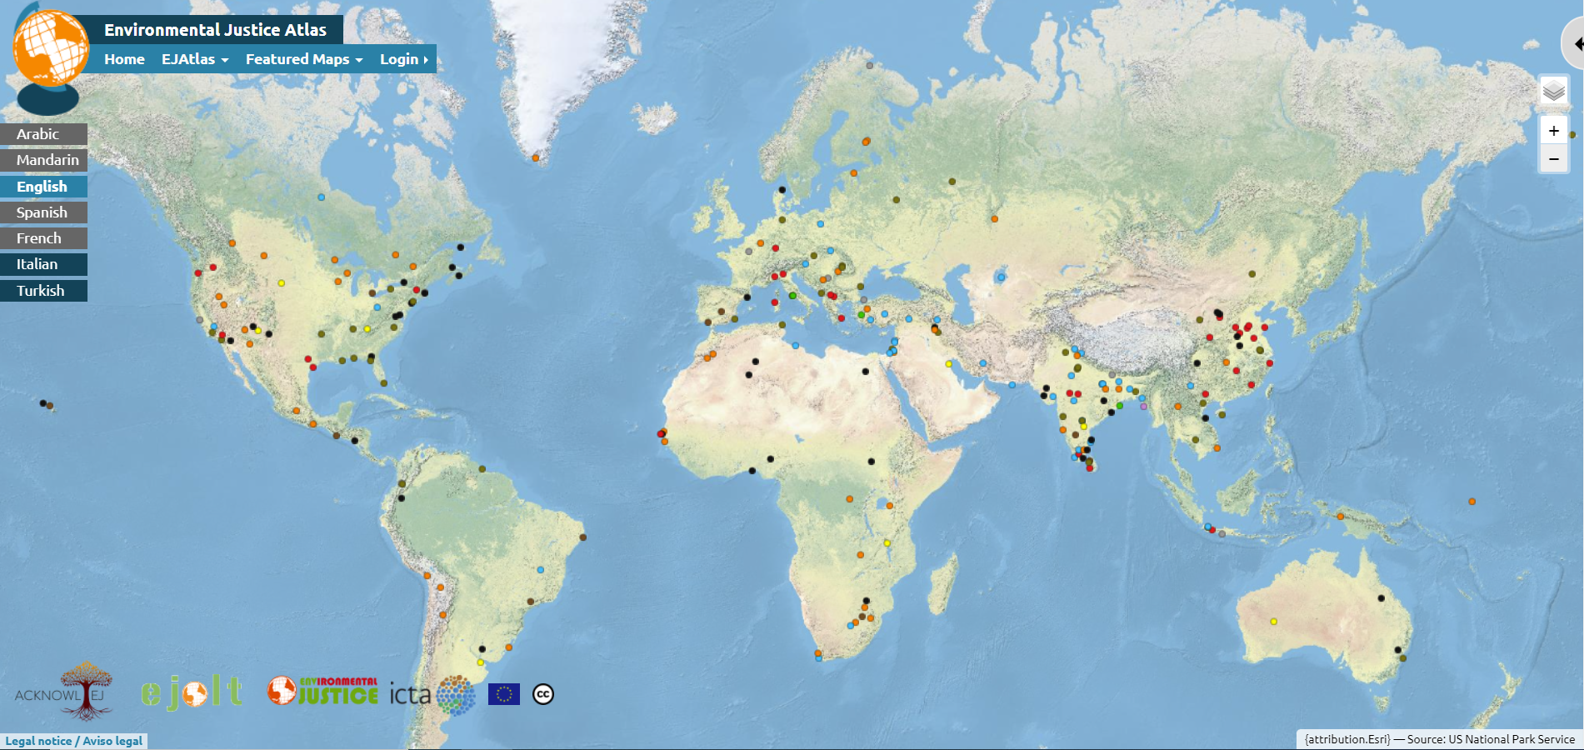
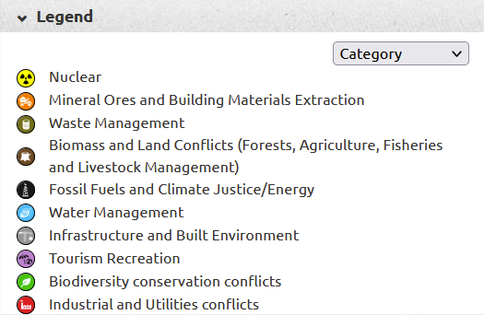
Groundwater environmental injustice and racism around the world
****(big asterix).... this data is a underrepresentation since reporting environmental injustice is challenging or impossible in parts of the world
Reference and weblinks: https://ejatlas.org/
Notes:
Slide developed by Chinchu Mohan

Slide 36
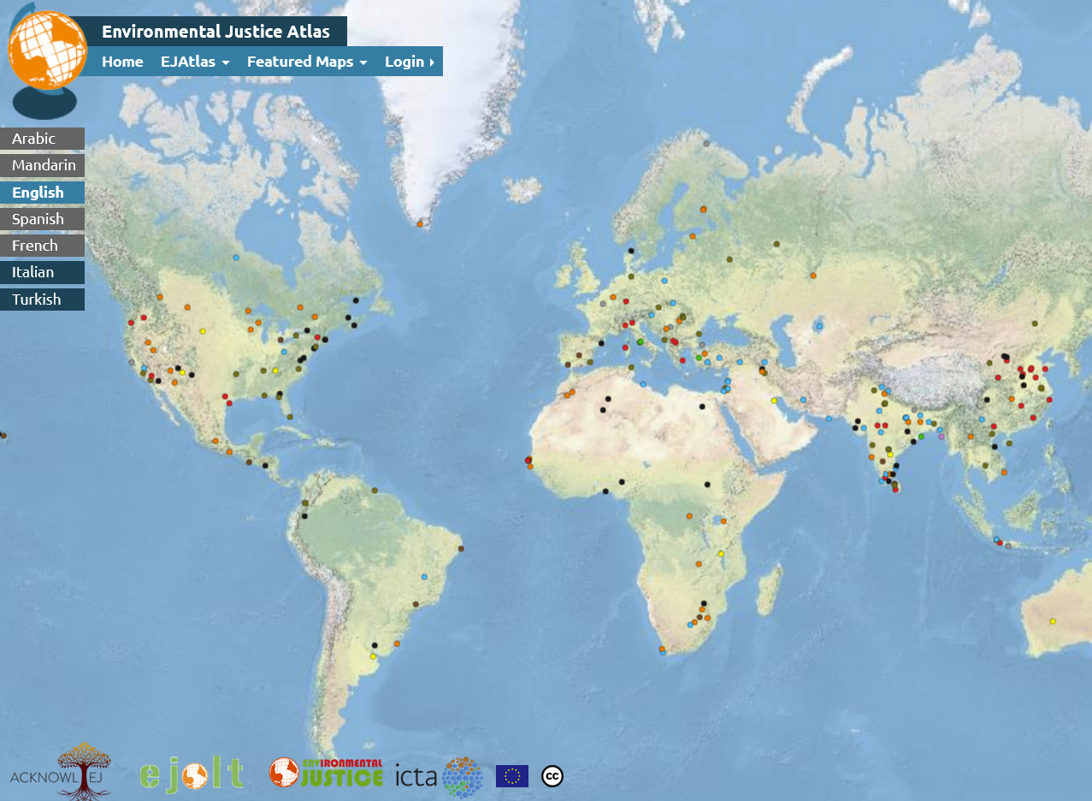
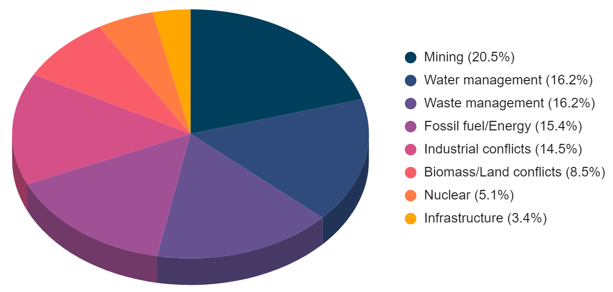
Mining Industry is the primary driver of groundwater-related injustice followed by water and waste management
Notes:
The bar diagram palette is color blind safe but the pie diagram is not. Can modify the pie diagram palette if necessary.
Link to compiled information and additional graphs: https://docs.google.com/spreadsheets/d/1bicx4Xn4G5gN2BEIhQIdyAYrIp6k1YMtsL_h7-vNWno/edit?usp=sharing
Data compilation, graph and slide developed by Chinchu Mohan

Slide 37
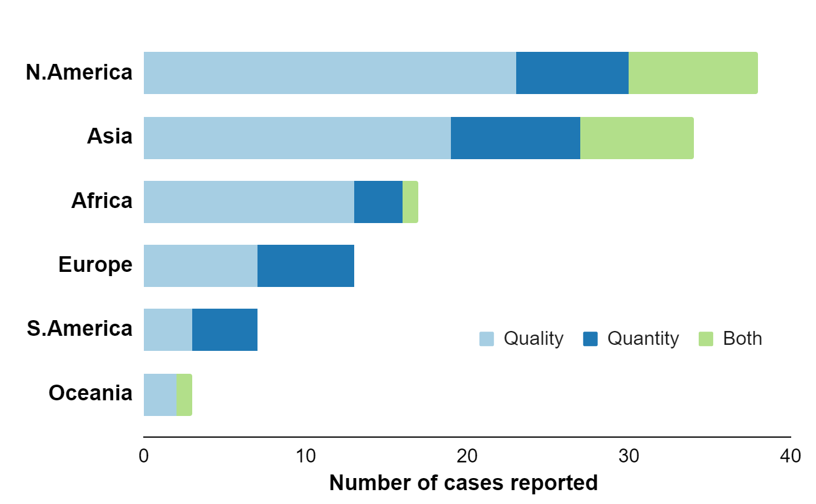
Most of the injustices are associated with groundwater quality
The number of groundwater quality injustice cases reported is over two times that of groundwater quantity injustice cases
Notes:
Data compilation, graph and slide developed by Chinchu Mohan

Slide 38
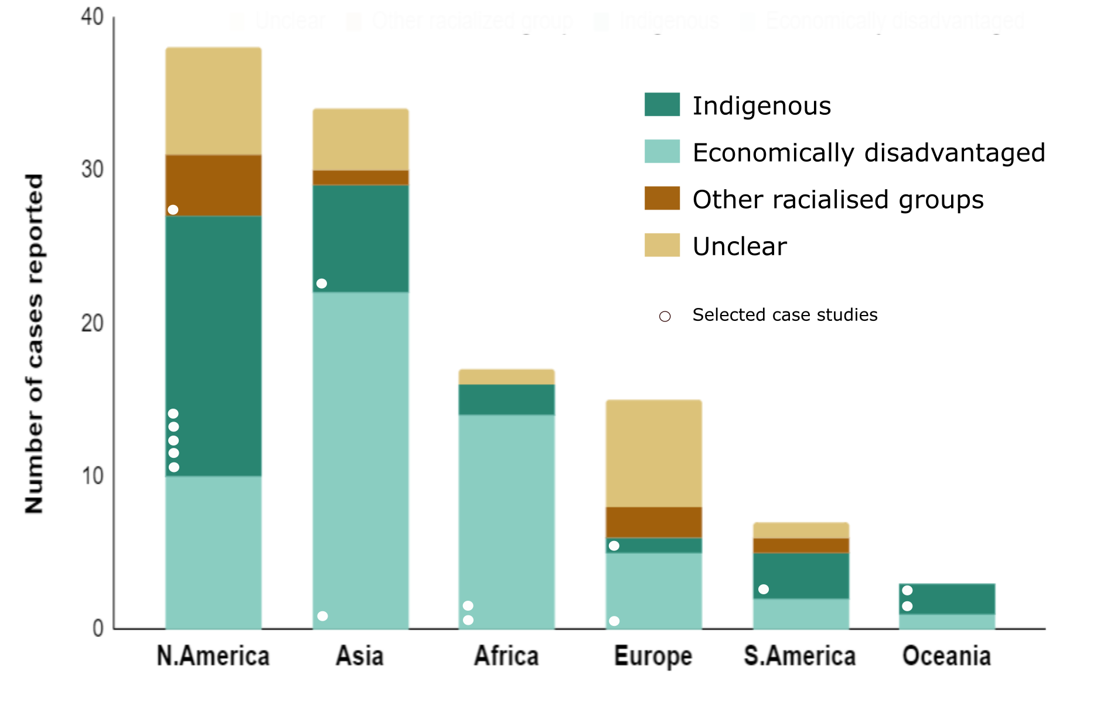
The primary groups impacted vary by region
In North America, Indigenous community faces the groundwater related injustice more. Whereas, in Asia and Africa, economically disadvantaged community faces more challenge
Case studies below are diverse but biased to North America
Notes:
Link to compiled information and additional graphs: https://docs.google.com/spreadsheets/d/1bicx4Xn4G5gN2BEIhQIdyAYrIp6k1YMtsL_h7-vNWno/edit?usp=sharing
Data compilation, graph and slide developed by Chinchu Mohan

Slide 39
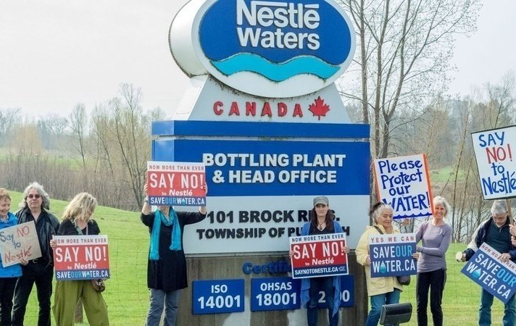
Six Nations drinking water supply is threatened by Nestle Corporation’s over pumping
Nestlé pumps springwater from the nearby Erin well, which sits on a tract of land given to the Six Nations under the 1701 Nanfan Treaty and the 1784 Haldimand Tract, said Lonny Bomberry, Six Nations lands and resources director
Excessive pumping resulted in decline in water table and shrinking of wetlands
It has also decimated the local populations of salmon, trout, pike and pickerel
Bright spot: None so far
Source: Jennifer Roberts/The Guardian
Ongoing challenge: Ontario government lifted the moratorium on water taking permits in April 2021
Ontario, ‘Canada’
Primarily impact groundwater quantity
Source: https://www.theguardian.com/global/2018/oct/04/ontario-six-nations-nestle-running-water
https://www.environment911.org/Understanding-the-Past-and-Future-Nestle-Corporations-Impact-on-Canadian-Waters-and-Communities
Notes:
Slide developed by Chinchu Mohan
In theory, the provinces have owned the water since 1930, when the federal government delegated ownership with the Natural Resources Transfer Act. According to that act, the provinces have the right to sell their water to whomever they want, including companies like Nestlé.
But water is also supposed to be regulated by the federal government, which is responsible for the natural environment and Canada’s waterways. And, according to the Canadian constitution, the federal government has a “duty to accommodate and consult” First Nations and to make sure other parties do the same when extracting any natural resource, including water, from indigenous land.

Slide 40
Indigenous fight against Coca-Cola in Plachimada, South India
In March 2000, Coca Cola started a bottling plant at Plachimada where majority of the population consists of adivasis (indigenous people)
About 2 million litres of water (primarily groundwater) per day was extracted by the company
Nearby wells started to run dry and the available water turned contaminated and toxic affecting around 1000 families
In 2002 villagers started protesting against the plant
Villagers protest in Plachimada
Contaminated well in Plachimada
Bright spot: By 2005 the plant was shut down
Ongoing challenge: Villagers still fighting for their compensation, 16 years after the Coca Cola factory in the Palakkad village shut down
Kerala, India
Primarily impact groundwater quality or quantity
Source: Suresh 2012; https://en.wikipedia.org/wiki/Plachimada_Coca-Cola_struggle
https://www.ritimo.org/The-Plachimada-Struggle-against-Coca-Cola-in-Southern-India
Notes:
Slide developed by Chinchu Mohan
The factory had also made a practice of distributing its sludge waste from the manufacturing process as free fertilizer to the villagers. In 2003, a BBC journalist visited the village to investigate the claims made by the villagers that the sludge was contaminated
the Coca Cola plant had not just violated the SC/ST Atrocities Act, it had also violated the Water Act (Pollution Control and Prevention), Environment (Protection) Act, Factory Law, Hazardous Waste (Management and Management Rules) Act, Scheduled Castes and Scheduled Tribes (Prevention of Violence) Act, Indian Penal Code, Groundwater Use Order, and Kerala Groundwater (Regulation and Regulation). The High Powered Committee’s report also pointed out that the law violated the Indian Assessment Act.

Slide 41
Now we can start to talk about the medicine…
environmental justice
Metaphor from Ingrid Waldron; images from noun project: medicine
Notes:
Noun project: medicine

Slide 42
Environmental justice (EJ) is the fair treatment and meaningful involvement of all people regardless of race, color, national origin, or income with respect to the development, implementation and enforcement of environmental laws, regulations and policies.
Meaningful involvement means:
People have an opportunity to participate in decisions about activities that may affect their environment and/or health;
The public's contribution can influence the regulatory agency's decision;
Community concerns will be considered in the decision making process; and
Decision makers will seek out and facilitate the involvement of those potentially affected.
Fair treatment means no group of people should bear a disproportionate share of the negative environmental consequences resulting from industrial, governmental and commercial operations or policies.
US EPA’s definition

Slide 43
Environmental Justice (EJ) began & continues as grassroots movement
1982: Black civil rights activists protesting landfill site in poor, Black community are credited for launching EJ movement
1991: First National People of Color Environmental Leadership Summit held in Washington DC; delegates drafted and adopted 17 principles of Environmental Justice
17 Principles of EJ have served as a defining document for the growing grassroots movement for environmental justice: http://www.ejnet.org/ej/principles.html
Notes:
Slide developed by Crystal Ng

Slide 44
Start of Environmental Justice Movement:
Black Civil Rights Movement + Groundwater Contamination Threat
http://www.citylab.com/politics/2015/11/how-the-collapse-of-soul-city-fired-up-the-environmental-justice-movement/415530/
1978: Warren County, North Carolina chosen as landfill site for toxic PCB chemicals
Warren County: highest percentage black residents, nearly lowest per capita income in N. Carolina
Water table only 7 ft from base of planned landfill
1982: Dumpsters met by protesters. >500 protesters arrested. Landfill goes in. Environmental justice starts as a movement
1994: Wells finally tested → PCBs, dioxins present
2002: Clean-up finally begins
Blog post
Notes:
Slide developed Crystal Ng and tweaked by Tom Gleeson

Slide 45
Tools to improve practices in environmental racism… part of the Environmental Justice toolbox
WALDRON Ingrid, 2020 “Environmental Racism in Canada” https://www.enrichproject.org/
Notes:
Slide developed by Tom Gleeson

Slide 46
Environmental Justice Toolbox
reconciliation and resurgence
laws
regulations/policies
improved practice
community action
education
Indigenous methodologies and knowledge
Two-eyed seeing
These notes focus on the tools in the red boxes which are most important for engineers to learn about as part of their education (last tool)
Geospatial, statistical or demographic analysis
Community based research and knowledge co-production
Blue boxes are additional tools discussed in these notes
Green boxes from Waldron, 2020 “Environmental Racism in Canada”
Notes:
Slide developed by Tom Gleeson; Icon from noun project: toolbox
How do you pick the right tool?

Slide 47
Reconciliation
The Truth and Reconciliation Commission was created in 2008 to document and share the experiences of Indian Residential School Survivors. This included a list of calls to action for the Canadian Government and associated organizations, to commit to creating equity and restitution protocol to put into practice.
Reconciliation is a contentious topic within Indigenous communities and means different things to different people.
Other videos to check out…
Murray Sinclair, Chair of TRC
#MyReconciliationIncludes
Canadian Shame: A History of Residential Schools
Notes:
Text of slide written by Noella Horoscoe, edited by Summer Okibe and videos added by Tom Gleeson (Nov 2021-Jan 2022).

Slide 48
Resurgence
Resurgence is the practice of enacting traditional Indigenous ways of being into a contemporary setting as a form of cultural reclamation. This can include returning to life ways that have sustained Indigenous peoples since time immemorial as well as incorporating cultural aspects such as language into day to day life.
Other video and info:
https://www.ienearth.org/
Notes:
Text of slide written by Noella Horoscoe, edited by Summer Okibe and videos added by Tom Gleeson (Nov 2021-Jan 2022). First two minutes of video is clear introduction to resurgence by Taiaiake Alfred who has now resigned from UVic.

Slide 49
Breakout groups!
Now that you have learned a bit more about ‘Territory and treaty rights’, ‘settler colonialism’ and ‘Reconciliation and resurgence’ discuss how do these concepts relate to the Indigenous territory that you grew up in or worked in during coop terms
Notes:
Activity suggested by Noella Horoscoe.
IDEAS
Territory and treaty rights: Power of the first inhabitants, Authority, Law, land rights.
Settler colonialism: “The whiteman syndrome,” pain, anguish, and suffering of the colonized.
Reconciliation and resurgence: Peacemaking and acknowledgment of wrongdoings to the colonized.

Slide 50
Indigenous Methodologies
Indigenous Methodology is an act of reclaiming, revivance, and retelling, weaving Indigenous knowledge into discussions of Indigenous histories.
Useful resource list of Indigenous research methodologies
Wilson, 2001

Slide 51
Indigenous Methodologies
The 3 R’s of Indigenous Research Methodologies (Wilson, 2008): Respect, Reciprocity and Relationality
Indigenous Research Methodologies: chuutsqa's Story
Notes:
Content from Crystal Tremblay (UVic Geography), slide developed by Tom Gleeson

Slide 52
Indigenous Knowledge (IK) /
Traditional Knowledge (TK) / Traditional Ecological Knowledge (TEK)
Indigenous Knowledge can be broadly defined as the complex knowledge systems that have developed over time by a particular people in a particular area and that have been transmitted from generation to generation. It includes ecological, scientific, and agricultural knowledge in addition to processes of teaching and learning. It also encompasses both the traditional and the contemporary as Indigenous knowledge continues to expand and develop. Because Indigenous knowledge has often been referred to as “traditional knowledge,” some people view it as unchanging knowledge based only in the past. Instead it is “an adaptable, dynamic system based on skills, abilities, and problem-solving techniques that change over time depending on environmental conditions” (Battiste, 2005). The body of IK can no more be summed up than the body of knowledge of any other society. It is vast, and based on context, often connected to specific geographical areas. (from Jo Chrona)
Randy Herrmann, University of Manitoba
Overview of Indigenous and Western ways of knowing, and approaches for pairing
Notes:
Slide developed by Summer Obike; video added by Tom Gleeson → focus on 41:20 with Traditional Indigenous Design

Slide 53
Example of Traditional Knowledge of water
This teaching is based on:
Video link from https://www.waterteachings.com
Notes:
Slide developed by Tom Gleeson

Slide 54
Example of Traditional Knowledge of water
Water is alive. It is a being with its own spirit.
Water is sacred.
Water is a relative.
Water is part of a holistic system, a part of Creation.
Water is key to survival.
Women have a central role.
Language retention is critical.
This example of Traditional knowledge is from McGregor (2012) and summarizes perspectives of Chiefs of Ontario. McGregor notes that “It is risky to treat First Nations as a homogeneous group. If there was one area, however, in which attitudes were widely shared, it was traditional beliefs and attitudes toward water. In addition to sustaining life itself, water was traditionally a means of transportation, or a source of food, or both, for every First Nation and remains central to the lives of many communities today. The pervasiveness of this traditional view of water and the related stewardship role for First Nations gave us a strong sense of how the goal of achieving safe drinking water on reserve should be pursued.” (Swain et al., 2006, p. 32)
Notes:
Slide developed by Tom Gleeson

Slide 55
Indigenous-led Environmental Assessment (EA)
example…
https://stkemlups.ca/wp-content/uploads/2013/11/2017-03-ssnajaxdecisionsummary_0.pdf
https://thenarwhal.ca/how-indigenous-led-environmental-assessments-could-ease-resource-pipeline-gridlock/
https://www.facetsjournal.com/doi/10.1139/facets-2019-0039
Notes:
Slide developed by Tom Gleeson; image from https://www.flickr.com/photos/pmtrudeau/39087677804/in/dateposted/
This example and others described in Curran “Indigenous Processes of Consent: Repoliticizing Water Governance through Legal Pluralism” https://www.mdpi.com/2073-4441/11/3/571

Slide 56
Two-eyed seeing
Albert Marshall - a leading environmental voice in Unama’ki Cape Breton. He is advisor to and is a highly regarded spokesperson for Mi’kmaq natural resources and environmental issues.
https://www.waysofknowingforum.ca/blog/2020/11/7/dialogue-4-resources-for-further-reading
https://www.uinr.ca/people/albert-marshall/
https://www.aptnnews.ca/investigates/mikmaq-caught-up-in-forced-relocation-say-apology-is-essential/attachment/mikmaw-relocation-5-1000-x-562-copy/
Notes:
Slide developed by Tom Gleeson

Slide 57
Two-eyed seeing
Andrea Reid et al 2020
Notes:
Slide developed by Tom Gleeson

Slide 58
Two-eyed seeing to pair knowledge from different knowledge systems
What is problematic about using a bridge as an image of ‘two-eyed seeing’?
Abu et al. 2020

Slide 59
Two-eyed seeing in the field
Pilot Collaborative Water Monitoring Program, Northeastern British Columbia
Notes:
Slide developed by Tom Gleeson

Slide 60
Three levels of legal implementation and practice
Acts/Bills
passed in Legislature
Hard to change
more likely to be used by practitioners on specific projects
Regulations
Approved by cabinet (Royal Assent by the Governor General)
Clarifies Act
Link
Policies
Issued by senior bureaucrats
Define operations for staff
Link
https://www.justice.gc.ca/eng/laws-lois/index.html
Notes:
Slide idea by Chinchu Mohan and Summer Okibe, some content developed by Tom Gleeson

Slide 61
Legal Brightspots, mostly at the as Acts/Bills
Bill C-230: A National Environmental Racism Strategy (At the Report Stage - House of Commons)
Bill C-28: to reform the Canadian Environmental Protection Act (CEPA) (At the Second Reading Stage - House of Commons)
Bill C-15: The United Nations Declaration on the Rights of Indigenous Peoples Act (UNDRIPA). (Became law in Canada in June 16, 2021).
Bill C-41: Declaration on the Rights of Indigenous Peoples Act (DRIPA). (Became law in British Columbia in November 28, 2019).
Bill no. 31: Redressing Environmental Racism Act in Nova Scotia (At the First Reading Stage)
But ongoing challenges at level of Regulations and Policies
https://www.justice.gc.ca/eng/laws-lois/index.html
Notes:
Slide developed by Summer Okibe and Chinchu Mohan

Slide 62
UNDRIP AND DRIPA (in British Columbia)
UNDRIP:
An international instrument to enshrine the rights that “constitute the minimum standards for the survival, dignity and well-being of the Indigenous peoples of the world.”
46 articles (from culture to religion to health)
Adopted by 148 nations, incl. CAN since 2016
DRIPA:
Mandates government to bring provincial laws into harmony with the UN Declaration
Requires development of action plan
Requires regular reporting to the Legislature
“By ignoring Indigenous water rights and allocating water based on the colonial system of prior allocation, … the Water Sustainability Act is inconsistent with UNDRIP.” (Gullason, 2018)
Notes:
Slide developed by Xander Huggins; could be modified to discuss similar legislation (or lack thereof) in your jurisdiction

Slide 63
Water sustainability in British Columbia
Water Sustainability Act, 2014
Key elements
Environmental flow protections
Groundwater licensing
Monitoring & planning tools
Water objectives
Possibility for shared decision making
Water Sustainability Plans (WSPs): Plans that are initiated by the Minister (FLNRORD) to assist in preventing (see below) and can suggest delegated decision making.
Conflicts between water users
Risks to water quality
Risks to aquatic ecosystem health
Restoration measures
Water Objectives: Specific place-based (watershed, stream, aquifer, etc.) water objectives, proposed by WSPs, and enforced by regulation.
Notes:
Slide developed by Xander Huggins; could be modified to discuss similar legislation (or lack thereof) in your jurisdiction

Slide 64
But implementation of the Water Sustainability Act has been slow and partial
“No water sustainability plans have been started; no water objectives have been set; water licence holders still do not have to account for their water use; and groundwater licensing is superficially underway as timelines drag out.”
Inadequate flows for fish are only getting worse in water-stressed parts of the province, big industrial users are permitted to extract water at virtually no cost, and boil-water advisories are far too frequent. Communities are feeling water insecure and concerns are mounting.”
Important next steps:
Must bring WSA inline with UNDRIP
WSA must be actively deployed to solve the water problems communities are experiencing
Develop a permanent, sustainable Watershed Security Fund supports First Nations, communities, and local governments
https://theprovince.com/opinion/oliver-brandes-deborah-curran-aaron-hill-rosie-simms-and-coree-tull-waiting-for-water-leadership
Notes:
Slide developed by Tom Gleeson; could be modified to discuss similar legislation (or lack thereof) in your jurisdiction

Slide 65
Reconciliation Calls to Action for Natural Scientists (also relevant for engineers)
1. We call on natural scientists to understand the socio-political landscape around their research sites.
2. We call on natural scientists to recognize that generating knowledge about the land is a goal shared with Indigenous peoples and to seek meaningful relationships and possible collaboration for better outcomes for all involved
3. We call on natural scientists to enable knowledge sharing and knowledge co-production
6. To decolonize the landscape, we call on natural scientists to incorporate Indigenous place names as permitted.
7. We call upon natural scientists and their students to take a course on Indigenous history and rights.
Notes:
Slide developed by Tom Gleeson

Slide 66
Geospatial, statistical or demographic analysis
major natural gas pipelines crisscrossing the country are disproportionately concentrated in vulnerable counties, those considered more likely to be affected by hazards and disasters.
Emmanuel et al. 2020 discussed in Water Wisdom: The Indigenous Scientists Walking in Two Worlds
Notes:
Slide developed by Tom Gleeson after conversation with Ryan Emmanuel

Slide 67
Geospatial, statistical or demographic analysis
Video or info to check out…
Public Participation GIS: http://www.ppgis.net/videos/english/
W̱SÁNEĆ Territory mapping and declaration
https://www.indigenousmaps.com/indigenous-mapping-collective/
Notes:
Content suggested by Crystal Tremblay, slide developed by Tom Gleeson

Slide 68
Geospatial analysis in breakout groups
CalEnviroScreen is a screening methodology that can be used to help identify California communities that are disproportionately burdened by multiple sources of pollution
Description
Tool
Similar to EPA’s EJScreen
Description
Tool
Use the CalEnviroScreen or EPA EJScreen to compare the distribution of Impaired Water Bodies and Poverty (or other Population Characteristics)
Notes:
Activity suggested by Debra Perrone

Slide 69
Community based research and knowledge co-production
Inform
Consult
Involve
Collaborate
Co-create
LOW
HIGH
engagement and reciprocity
Community-based participatory research seeks to democratize knowledge creation by validating multiple sources of knowledge and promoting the use of multiple methods of discovery and dissemination. The goal of CBPR is social action (broadly defined) for the purpose of achieving (directly or indirectly) social change and social justice.
https://www.communityresearchcanada.ca/
Notes:
Content from Crystal Trembly (UVic Geography) and modified by Tom Gleeson

Slide 70
Best practices for partnering with Indigenous communities
Notes:
Slide developed by Kristina Disney, modified by Tom Gleeson

Slide 71
Decreasing summer low flows in Xwulqw'selu Sto'lo (Koksilah Watershed, BC) impact salmon and people
Summer flows in the Koksilah River have been exceptionally low in recent years at times when demand for water is the greatest threatening the survival of resident and anadromous salmonid species and the aquatic ecosystem.
Xwulqw'selu Sto'lo is unceded Cowichan Tribes territory and the fisheries are treaty rights.
Summer low flows are decreasing due to climate change, agricultural irrigation and possibly forestry
Bright spot: Cowichan Tribes and the Province of British Columbia are scoping the possibility of co-management with a Wastershed Sustainability Plan.
Tim Kulchyski, Cowichan Tribes member and fisheries biologist, The Narwhal
Ongoing challenge: Extreme low flows caused Province to restrict groundwater use by agriculture
British Columbia, ‘Canada’
Primarily impact groundwater quantity
Reference and weblinks:
https://www.koksilahwater.ca/watershed
https://thenarwhal.ca/bc-koksilah-water-sustainability-plan/
Notes:
The Koksilah Watershed is located south of Duncan on Vancouver Island, within the traditional territories of Cowichan Tribes, Malahat Nation and other First Nations.
The Koksilah River is valued for its cultural and spiritual significance, fish, wildlife, is a water source for nearby farms and vineyards, and recreational opportunities. The majority of the watershed is privately managed forest lands.
Slide developed by Tom Gleeson

Slide 72
Summer low flows in the Xwulqw'selu Sto'lo (Koksilah Watershed) are important to salmon and people
Survey from Modus 2021 report
See much more info and reports at koksilahwater.ca/watershed or Narwhal article A plan to heal the Koksilah watershed
Notes:
Slide developed by Tom Gleeson

Slide 73
Multiple causes for decreasing summer low flows in the Xwulqw'selu Sto'lo (Koksilah Watershed)
Graphs from Hatfield 2021 report
See much more info and reports at koksilahwater.ca/watershed or Narwhal article A plan to heal the Koksilah watershed
Notes:
Slide developed by Tom Gleeson

Slide 74
Breakout groups!
Rank and justify the top three specific tools (not just general categories such as ‘Laws’) that you think are most appropriate for applying in the Koksilah Watershed case study
Criteria for ranking should include:
Likely usefulness of the tool to problem
Appropriateness of you using the tool given your social location
Notes:
Activity suggested by Noella Horoscoe.
IDEAS
Territory and treaty rights: Power of the first inhabitants, Authority, Law, land rights.
Settler colonialism: “The whiteman syndrome,” pain, anguish, and suffering of the colonized.
Reconciliation and resurgence: Peacemaking and acknowledgment of wrongdoings to the colonized.

Slide 75
Additional resources for help students to keep learning and engaging
Notes:
Noun project: disease and medicine

Slide 76
Potential resources
Many useful educational resources: National Centre for Truth and Reconciliation - Education
or the TRC REPORTS: https://nctr.ca/records/reports/
Canadian Shame: A History of Residential Schools: TedX talk by Ginger Gosnell-Myers, of Nisga’a and Kwakwaka’wakw heritage, is a policy expert, researcher, and activist.
Voices From Here: Excellent series of 10-15min videos featuring first-person stories of 9 different Indigenous people from across the country.
Four Seasons of Reconciliation (and pdf)
Indigenous Canada course
Indigenous Corporate Training
Notes:
Slide developed by Tom Gleeson

Slide 77
Resources and examples of decolonizing engineering and water
https://apsc.ubc.ca/EDI/truth-and-role-engineers-in-decolonization
https://decolonizingwater.ca/
https://www.researchgate.net/publication/277992187_Decolonization_Is_Not_a_Metaphor
Notes:
Slide developed by Tom Gleeson

Slide 78
Additional resources for Indigenous Methodologies
Involvement of Elders: Elders are an important part of the Indigenous culture because of the traditional knowledge that they impart. They carry the traditional teachings, the ceremonies, and the stories of all our relations. For research to be based on Indigenous knowledge, elders need to be included. Reserve communities typically have a band council and engage specified elders to act as advisers. Researchers typically address the band council and/or elders before doing research with the community.
https://www.nwic.edu/wp-content/uploads/2016/08/Dont-talk-about-what-you-dont-know.-on-not-conducting-research-with-in-Indigenous-contexts.pdf
https://jps.library.utoronto.ca/index.php/des/article/view/21166
https://journals.sagepub.com/doi/full/10.1177/00178969211009269
Notes:
Slide developed by Summer Obike with papers suggested by Noella Horsecoe

Slide 79
Additional resources for working across knowledge systems
Global Water Futures approach and conference
https://eos.org/features/water-wisdom-the-indigenous-scientists-walking-in-two-worlds
(noting that video generally centres non-Indigenous voices)
Notes:
Slide developed by Tom Gleeson

Slide 80
Working definitions for Equity, Diversity and Inclusion (EDI)
Equity is defined as the removal of systemic barriers and biases enabling all individuals to have equal opportunity to access and benefit from the program.
To achieve this, all individuals who participate in the research ecosystem must develop a strong understanding of the systemic barriers faced by individuals from underrepresented groups (e.g., women, persons with disabilities, Indigenous Peoples, racialized minorities, individuals from the LGBTQ2+ community) and put in place impactful measures to address these barriers.
Diversity is defined as differences in race, colour, place of origin, religion, immigrant and newcomer status, ethnic origin, ability, sex, sexual orientation, gender identity, gender expression and age.
A diversity of perspectives and lived experiences is fundamental to achieving research and training excellence.
Inclusion is defined as the practice of ensuring that all individuals are valued and respected for their contributions and are equally supported.
Ensuring that all team members are integrated and supported is fundamental to achieving research and training excellence.
Link
Notes:
Slide developed by Tom Gleeson

Slide 81
Visualization of Equality, Equity and Justice
Source: https://www.mobilizegreen.org/blog/2018/9/30/environmental-equity-vs-environmental-justice-whats-the-difference
Notes:
Slide developed by Chinchu Mohan

Slide 82
Integrating EDI
Integrating Anti-Racism
Consistently learning about EDI
Making the connection between diversity and engineering so evident that it’s impossible to discuss engineering or engineering education without acknowledging the Indigenous peoples.
To create a guide and an EDI group that would help integrate EDI in Engineers (For example, UofT’s Engineering EDI Action Group)
Having Engineering organizations geared towards EDI - Indigenous Engineering Students Association, Engineering Women Association, Black Engineering Association, etc.
Seeking partnerships with Indigenous communities.
To conduct practice-informed research that is focused on identifying areas of opportunity within engineering education to advance diversity, equity, and inclusion.
Set-up an Engineering toolkit to combat racism.
Join roundtable conversations to tackle racism. For example the B.C Community Roundtable on Anti-Racism in education
Rethink about the environment (This can be done by discussing real cases on environmental injustice on Indigenous peoples, Blacks and other minority groups).
Notes:
Slide developed by Summer Okibe, tweaked by Tom Gleeson

Slide 83
Resources for EDI Education
University of Washington Lib: Racial Justice Resources: Keeping Current
The Seattle Public Lib: A Toolkit for Anti-racism Allies | The Seattle Public Library
Science: Time to look in the mirror
Notes:
Materials found by Summer Okibe; slide developed by Tom Gleeson

Slide 84
Resources for Indigenous research ethics
https://aiatsis.gov.au/sites/default/files/2020-10/aiatsis-code-ethics.pdf
Notes:
Materials found by Summer Okibe; slide developed by Tom Gleeson

Slide 85
Additional case studies of groundwater-related environmental racism and injustice
(for Assignment 2)
Notes:
Noun project: disease and medicine

Slide 86
Characteristics of
case studies of
groundwater-related
environmental racism and environmental injustice...
Location with significantly impacted groundwater quality or quantity
Environmental racism refers to environmental policies, practices, or directives that disproportionately disadvantage individuals, groups or communities (intentionally or unintentionally) based on race or colour (Bullard, 2002). Fighting environmental racism is a subset of the larger environmental justice movement, which originated in the United States.
WALDRON Ingrid, 2020 “Environmental Racism in Canada” https://www.enrichproject.org/
Environmental justice is the fair treatment and meaningful involvement of all people regardless of race, color, national origin, or income, with respect to the development, implementation, and enforcement of environmental laws, regulations, and policies. US EPA definition
Bright spot
Ongoing challenge
Notes:
Slide developed by Tom Gleeson; Icons are ‘bright’ or ‘wrong’ from the Noun Project

Slide 87
Water Sustainability Act in British Columbia is a missed opportunity to acknowledge Indigenous Rights to water
UNDRIP states “Indigenous Peoples have the right to determine and develop priorities and strategies for the development or use of their lands or territories and other resources.”
But British Columbia continues to assume jurisdiction over water and ignore the “prior, superior and unextinguished water rights of Indigenous Nations of British Columbia.” (Union of British Columbia Indian Chiefs)
The WSA represents a missed opportunity to right a historic wrong perpetrated against Indigenous Peoples and develop an equitable and sustainable nation-to-nation water governance model
Mary Polak, introduced legislation to update and replace the province’s century-old Water Act. Water Canada
Bright spot: UNDRIP Act passed in BC Legislature
Ongoing challenge: Water Sustainability Act implementation has been slow and partial, and needs to be brought inline with UNDRIP (Opinion article)
British Columbia, ‘Canada’
Primarily impact groundwater quantity
Reference and weblinks:
Legal article with quotes above.
Notes:
Slide developed by Tom Gleeson

Slide 88
Increased cancer rates in Indigenous/Black community near Nova Scotia garbage dump
Disproportionate siting of polluting industries and other environmentally hazardous projects in Indigenous, Black and other marginalized communities.
The dump operated for 75 years, closing in 2016
High rates of cancer — and deaths — among members of Shelburne’s African Nova Scotian community, compared to their white neighbours on the other side of town
Source : ENRICH Project
Nova Scotia, ‘Canada’
Primarily impact groundwater quality
Source:
There is something in water
Conversation article; ENRICH project
Notes:
Slide developed by Summer Obike

Slide 89
Water Contamination in Nunavut
There is no drinkable water in Iqaluit due to contamination by petroleum products
Potable water has been shipped up to Iqaluit, because water is not drinkable even after boiled.
All residents are advised not to drink tap water, and pregnant women are advised not to bathe with tap water
The origin of contamination is suspected to be gas infrastructure that has not been updated since the 1960s, and has been disproportionately affected by climate change.
The main hospital in Iqaluit could not sterilize medical equipment for 7 days.
https://globalnews.ca/news/8273375/iqaluit-community-bands-drinking-water-contaminated-fuel/
Bright spot: Potable water has been shipped up to the North and testing is being done in other communities to ensure public safety; reverse osmosis purification is being implemented
Nunavut, ‘Canada’
Primarily impact groundwater quality
Ongoing challenge: Nunavut residents have not had clean drinking water since October 12th, 2021
https://www.theglobeandmail.com/canada/article-in-iqaluit-nunavuts-only-hospital-feels-the-ripple-effects-of-the/
https://www.gov.nu.ca/health/news/do-not-consume-advisory-iqaluit-drinking-water
Notes:
Slide developed by Noella Horsecoe

Slide 90
Daly River, Northern Territory, Australia
Debate on if groundwater irrigated ag. should expand to region
Groundwater dependent wetlands, seeps highly sensitive to pumping
Substantial Indigenous population (>25%) in the territory (Nauiyu is largest Indigenous community); at least 10 Indigenous language groups in the region
Wetlands of cultural significance, and biodiversity (including pig-nosed turtles)
Bright spot: ____?
Ongoing challenge:
Daly River, Northern Territory, AUS
Primarily impact quantity
A useful chapter for future reference Neal et al. 2016
Notes:
Slide developed by Xander Huggins

Slide 91
Indigenous water rights across the western United States.
Agua Caliente Band v. Coachella Valley Water District
held that tribal rights “do not distinguish between surface water and groundwater” and provide tribes with “superior” access to groundwater “appurtenant” to tribal reservations
tribes in the Klamath River basin in southern Oregon and northern California maintained large surface water rights to protect fish and riparian habitat.
Tribal groundwater rights may afford similar opportunities to protect groundwater-dependent ecosystems.
Ongoing challenge: 236 tribes in the western United States have lands with unresolved groundwater claims.
Western US
Primarily impact groundwater quantity
Womble et al. 2018
Notes:
Slide developed by Xander Huggins

Slide 92
Case studies of groundwater in Indigenous culture, around AUS
The Dreaming or Dreamtime is an English translation of an Aboriginal concept.
Dreamtime stories depict the very basic part of a long and complex event. Stories covered include: the creation of the land and life,
Many groundwater-related sites would be Dreaming sites because water that originates from below the ground would be deemed spiritually significant by Aboriginal people. The Dreaming significance of these sites, for instance, would link surface and sub-surface waters through cultural heroes.
The Rainbow Serpent is a prominent and powerful cultural hero in many Dreamtime stories, and these stories relate closely to groundwater sites.
Australia
Primarily impact groundwater quantity
Indigenous Knowledge Institute, Morridge et al.
Notes:
Slide developed by Xander Huggins

Slide 93
Social Justice and Groundwater Allocation in Agriculture:
A French Case Study
“...highlighted that farmers form their judgment of acceptability by articulating four main categories of arguments: ethical considerations, including those related to justice; implementation feasibility of the scenario; risks associated with the scenario; and unintended side effects.
Without a specific effort … there is a risk of seeing the debate play out not on the grounds of social justice, but rather on those of other dimensions of acceptability, and that the compromise on principles of justice give way to a balance of power.
Bright spot:
Ongoing challenge: how to promote social justice
considerations in complex decision
making environments?
France
Primarily impact groundwater quantity
Rinaudo et al. 2016
Notes:
Slide developed by Xander Huggins

Slide 94
No water for the poor: the Roma ethnic minority and local governance in Slovakia
“ not merely to point how the drinking water supply for Roma might be unaffordable, but we attempted to indicate how the interests of dominant groups at the local level and their decision making power might create particular conditions, resulting in kicking the interests of local Roma into the sidelines
“more than 150 Roma settlements/neighbourhoods in Slovakia where not one house was connected to a public water supply, and more than 370 were without sewerage systems in place
“The Romani, colloquially known as Roma, are an Indo-Aryan ethnic group, traditionally nomadic itinerants living mostly in Europe
Slovakia
Primarily impact groundwater quality
Wiki, WEF, Filcak et al. 2017
Notes:
Slide developed by Xander Huggins

Slide 95
Coal mining degrades grasslands and wetlands in Holingol, Inner Mongolia
8 years of mine operation had caused the local water table to drop by up to 100 m, and the local lake to shrink by 62%
Arsenic poisoning was threatening the lives of the nearly 300,000 people in this region; 2000 were already sick and many died of cancer, producing cancer villages
The drastic ecological impacts have forced thousands of local residents to become ‘ecological migrants’
Indigenous Mongols, once nomadic pastoralists, are often the target of ‘ecological resettlement’, compelled to practice de facto sedentarized livestock raising
Grassland subsidence due to lowering of water table caused by coal mining. (Photo: Lu Guang, courtesy of Greenpeace)
Region or Country: Northern China
Primarily impact groundwater quality and quantity
Source: Qian et al. 2014
Notes:
Slide developed by Chinchu Mohan
The first surface coal mine in this region was the Holingol open pit coal mine, which began in 1979 with a coal production capacity of 300 000 tons per year. By 2004, however, the coal production capacity had dramatically expanded to 12 500 000 tons per year.
At the costs of the environment and local residents’ livelihood, Inner Mongolia has since 2002 experienced an economic boom based on mining. The wealth from the economic boom has not been fairly distributed
Ordos became one of the wealthiest cities in China. However, ordinary Mongolian herdsmen are not benefiting from that boom, which is based on exploitation of what they view as their resources
coal pollution in North China is shortening life expectancy by 5.5 years

Slide 96
Texaco-Chevron petroleum exploitation in the Ecuadorian Amazon
Texaco-Gulf conducted petroleum extraction in Ecuador between 1964-1992, before the company was acquired by Chevron in 2001.
Texaco drilled 339 wells in 15 petroleum fields, and the company abandoned 627 toxic wastewater pits - impacting five indigenous groups in Ecuador’s Amazon region—the Cofan, Secoya, Siona, Huaorani, and Quichua¹
Result: severe contamination of groundwater, soil, and surface streams with dangerous hydrocarbons and heavy metals.
Cancer rates in the communities exposed to petroleum contamination are 3x greater Ecuador’s average,¹ and the rate of miscarriages is 2x greater.¹
A lawsuit was opened against Texaco in 1993, driven by 30,000 local residents & 5 indigenous tribes.² In 2011, Chevron was found guilty & was ordered to pay $9 billion for remediation.
Bright spot: ?
Ongoing challenge: Chevron refused to pay for remediation and appealed the court’s ruling.³ The contamination persists, continuing to negatively impact indigenous peoples and the environment
Amazon Rainforest, Ecuador
Primarily impact groundwater & surface water quality
http://www.ejolt.org/wordpress/wp-content/uploads/2015/08/FS-42.pdf
https://www.bbc.com/news/world-latin-america-45455984
https://chevrontoxico.com/
Notes:
Slide developed by Aly Jacoby

